Slide 1

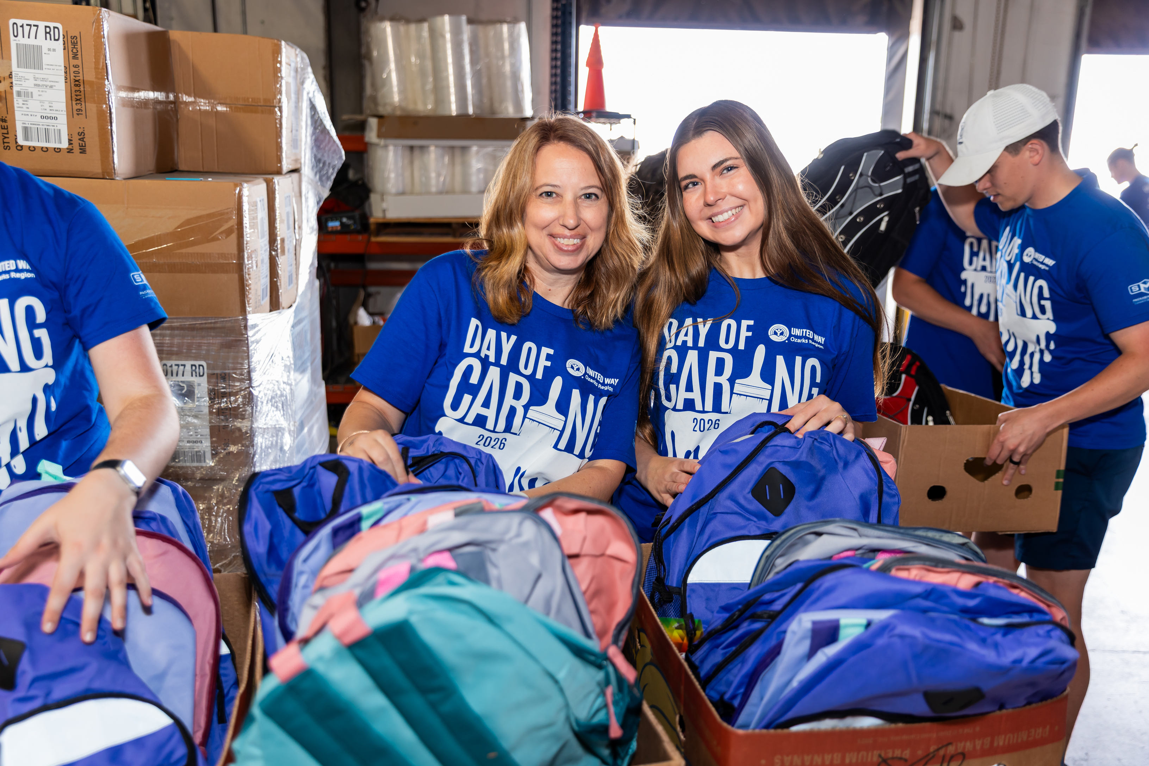


‹#›

Slide 2
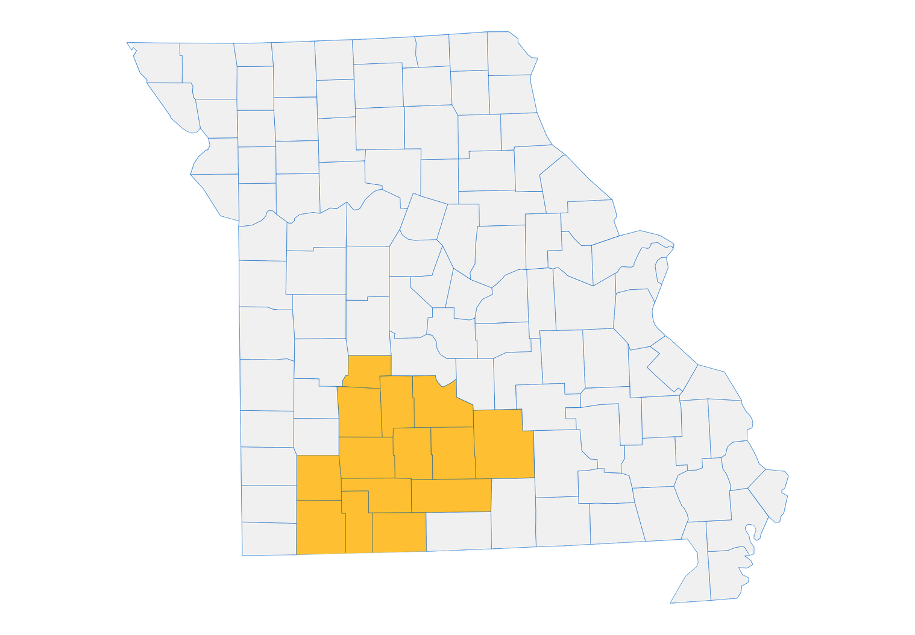
SUPPORTING OUR COMMUNITY
$2.01
MILLION
REINVESTED IN
COUNTIES
14
BARRY
CHRISTIAN
DALLAS
DOUGLAS
GREENE
HICKORY
LACLEDE
LAWRENCE
POLK
STONE
TANEY
TEXAS
WEBSTER
WRIGHT
UNITED IS
THE WAY.
2025 CAMPAIGN

Slide 3
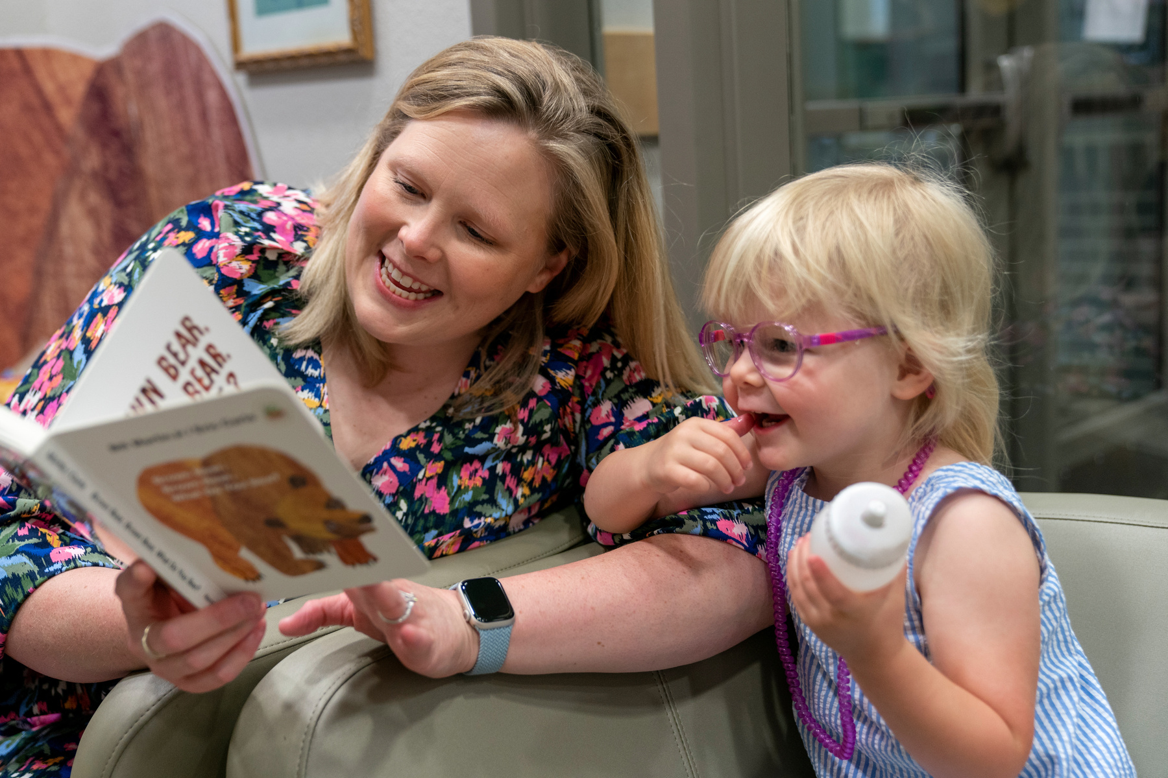
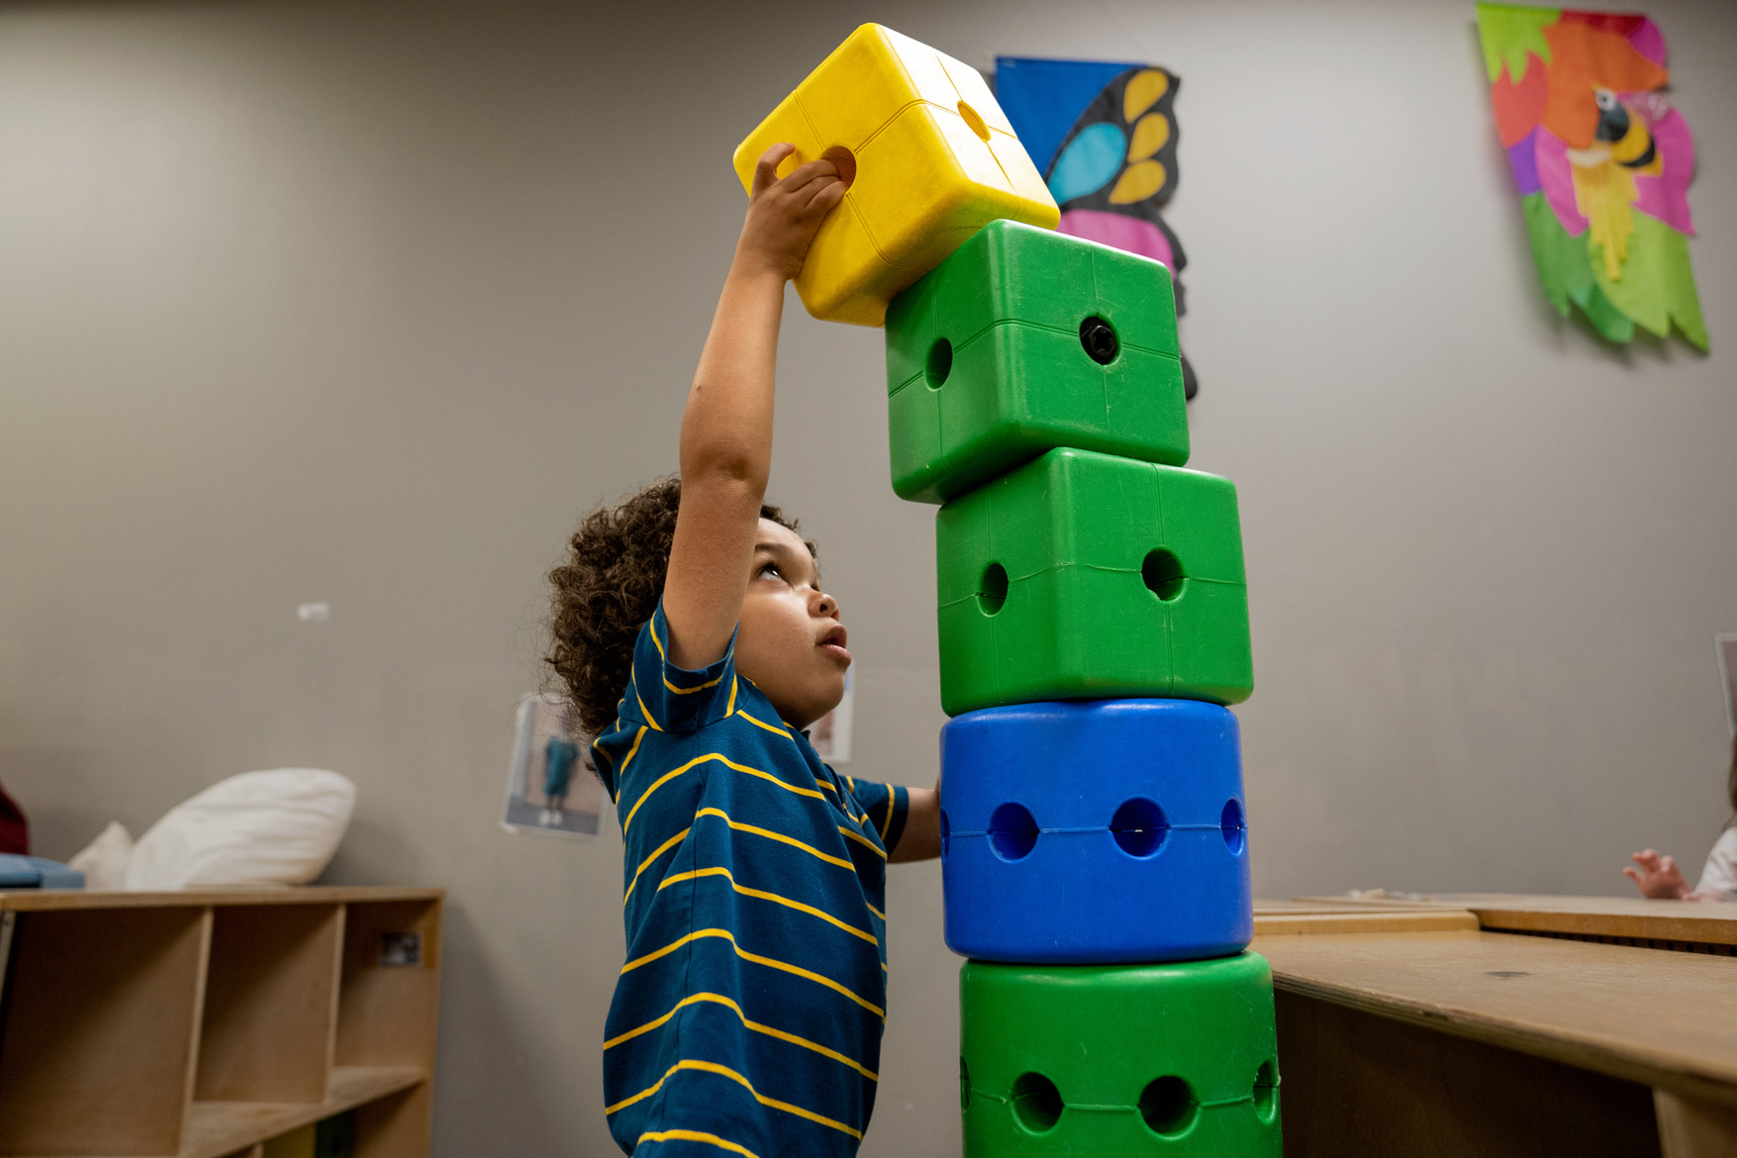
CHAMPIONING
CHILDREN
Ensuring our community’s children reach their full potential, by achieving milestones in development, education and health.
UNITED IS
THE WAY.
‹#›

Slide 4
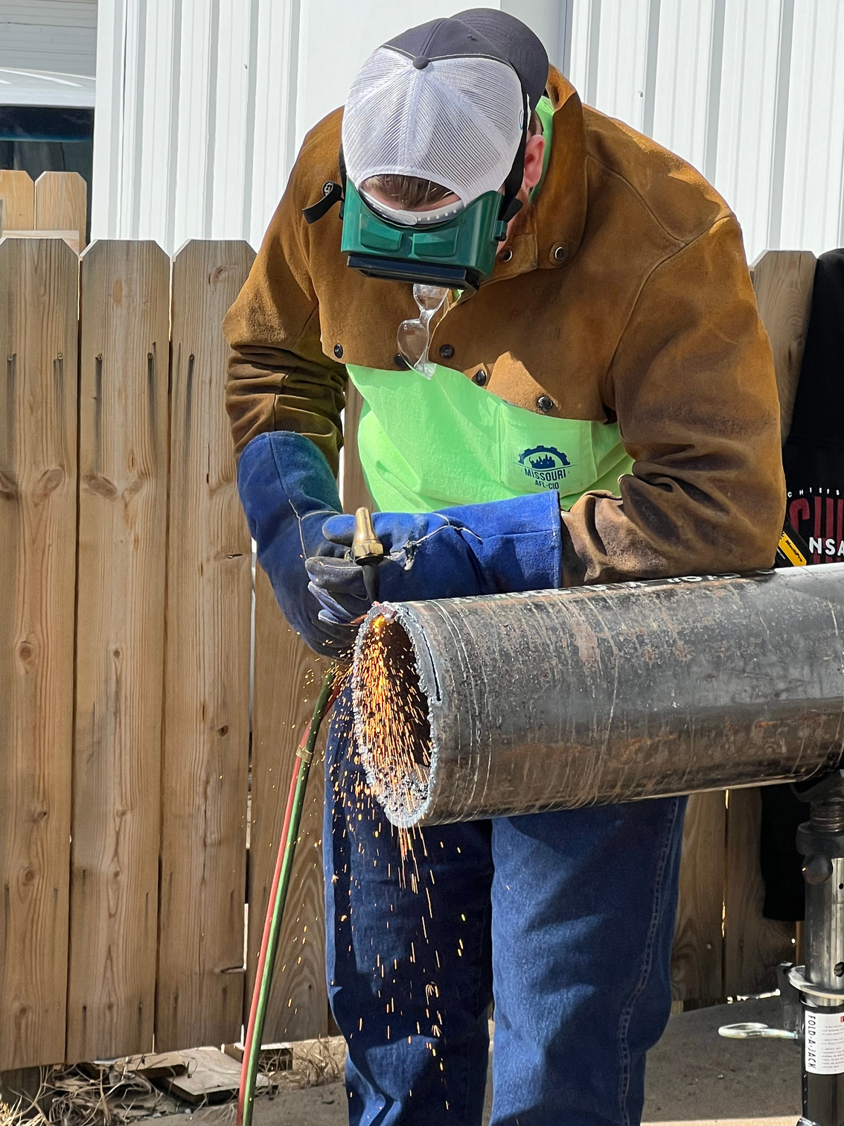
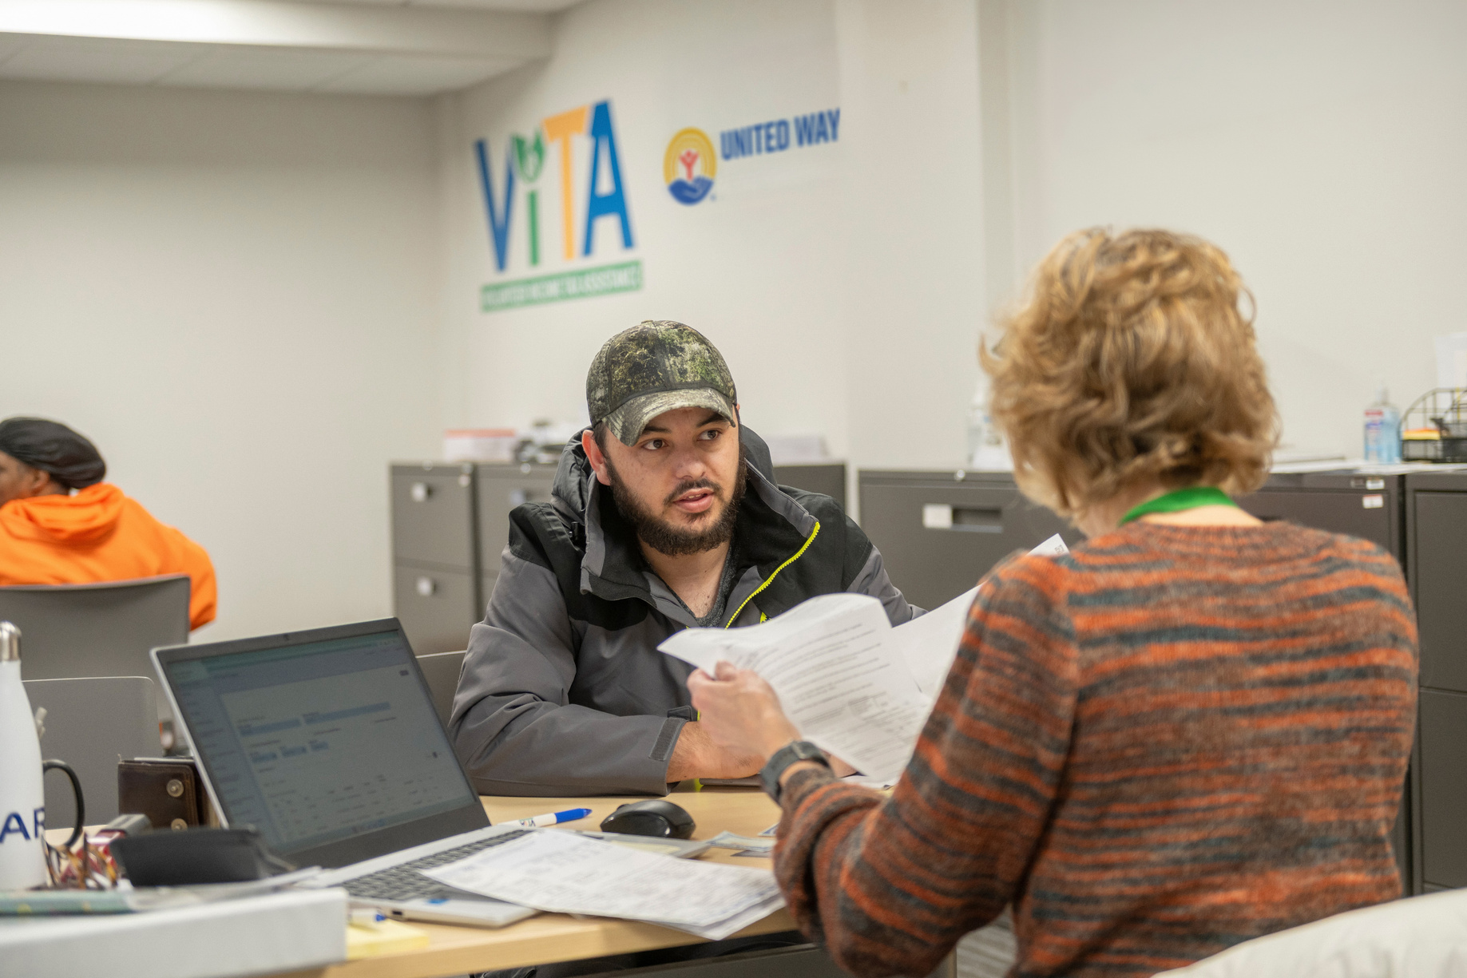
PATHWAYS OUT
OF POVERTY
Helping people build brighter futures through stable housing, workforce readiness and financial literacy.
UNITED IS
THE WAY.
‹#›
Notes:
Statement about focus changes:
"Over the next year, you’re going to start hearing about some adjustments in our mission at United Way. We’ve already begun working with key partners and stakeholders to plan for these changes and identify the areas where we can take an even stronger leadership role in our community. So stay tuned because we are so excited to share where we are headed as we sharpen our focus to bring real and lasting change to the Ozarks Region"

Slide 5
YOUR IMPACT
$1
PER MONTH
IT ONLY TAKES A FEW DOLLARS A MONTH
TO TRANSFORM A LIFE!
ONE CHILD CAN ACCESS ABUSE PREVENTION & ESCAPE RESOURCES
  FREE COUNSELING
  RESOURCES TO PREVENT ABUSE
  TOOLS TO ESCAPE ABUSE
$3
$5
PER MONTH
PER MONTH
ONE PERSON CAN ACCESS PROGRAMS SUPPORTED BY UNITED WAY
  HOUSING ASSISTANCE
  FOOD SECURITY
  MENTAL HEALTHCARE
ONE CHILD CAN ACCESS VITAL SUPPORT
  QUALITY AFTER-SCHOOL CARE
  FOOD ON THE WEEKENDS
  LITERACY TUTORING
Based on impact numbers from July 1, 2024 - June 30, 2025

Slide 6
COMMUNITY INVESTMENT FUND
UNITED IS
THE WAY.
THE MOST POWERFUL WAY TO
IMPACT YOUR COMMUNITY
12
‹#›
Notes:
1. Employees are motivated to be the change in our community
2. Employees enroll in a workplace campaign
3. UWO pinpoints the most critical needs in the community
4. Donor-volunteers come together to determine the most impactful funding opportunities
5. Lives are changed

Slide 7














Access to Mental Healthcare
Parental Mental Health Wellness and Skills Enhancement Program
Community-Based One-on-one Mentoring
Shape-up Program
CASA Clubhouse Child Advocacy
PRIORITY PARTNER
19 FUNDED PROGRAMS AT 14 PARTNER NONPROFITS
Forensic Services Protecting Our Youth
Math and Reading Buddy Program
O’Reilly Center for Hope
Pediatric Therapies
New Pathways for Good Dads
Community Outreach Program Emergency Shelter
Ozarks Family Resource Center
Counseling and Education
Crisis Intervention and Advocacy
Weekend Backpack Program
Reading Tutoring

Slide 8


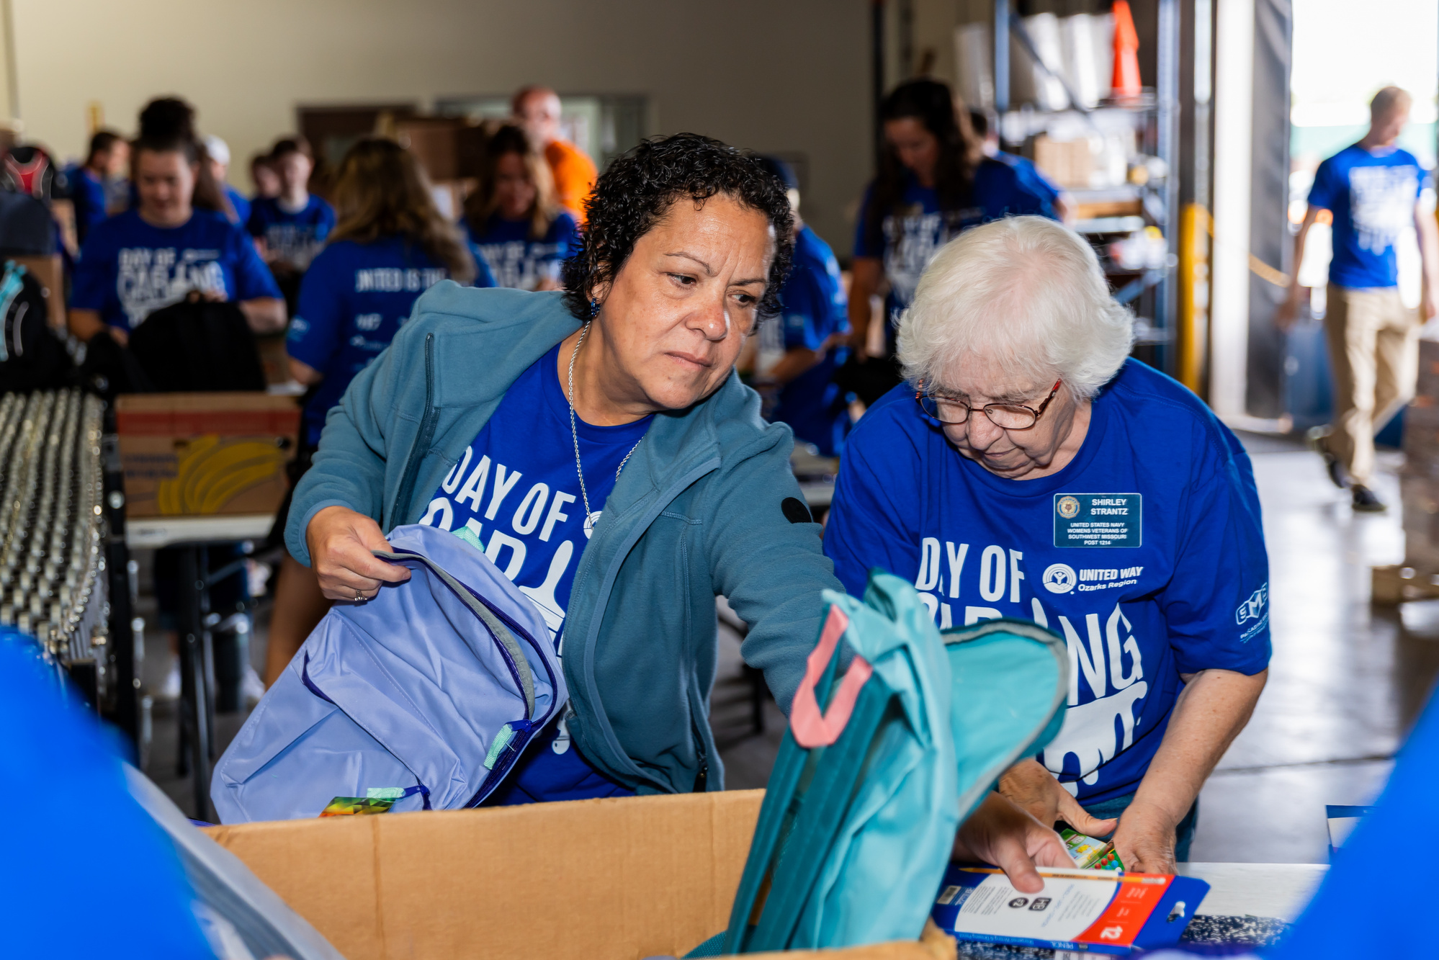
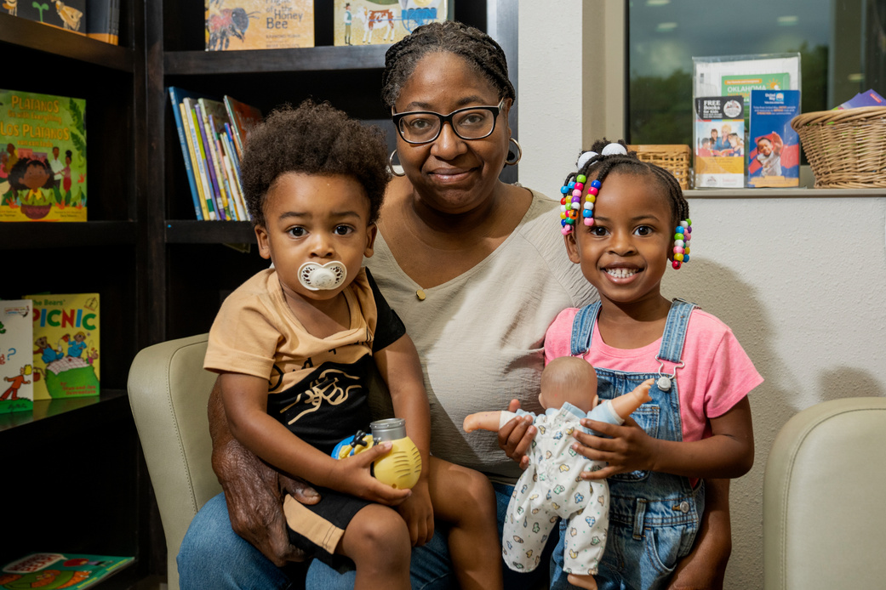
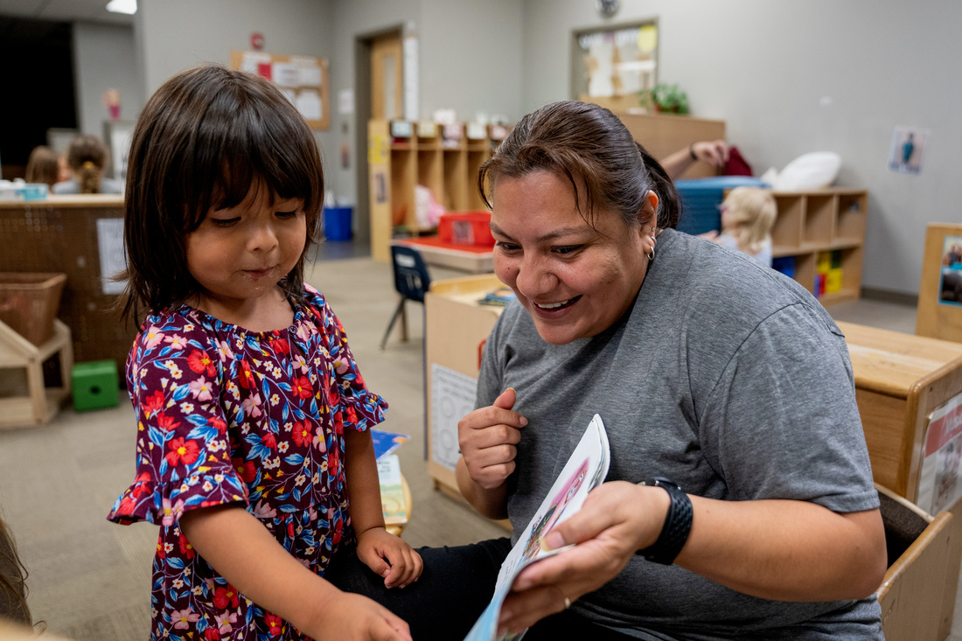
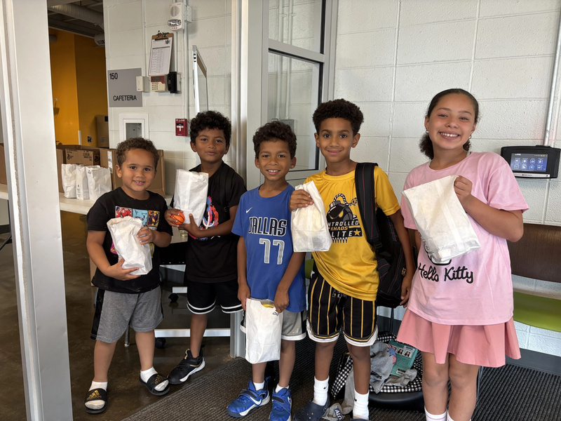
YOUR IMPACT
41,126
TOTAL LIVES IMPACTED
July 2025 - June 2026
4,371
PEOPLE SERVED THROUGH FOOD & NUTRITIION ASSISTANCE PROGRAMS
20,249
FAMILIES SERVED WITH CHILD DEVELOPMENT SUPPORTS
11,453
STUDENTS SERVED THROUGH OUT-OF-SCHOOL SUPPORTS

Slide 9

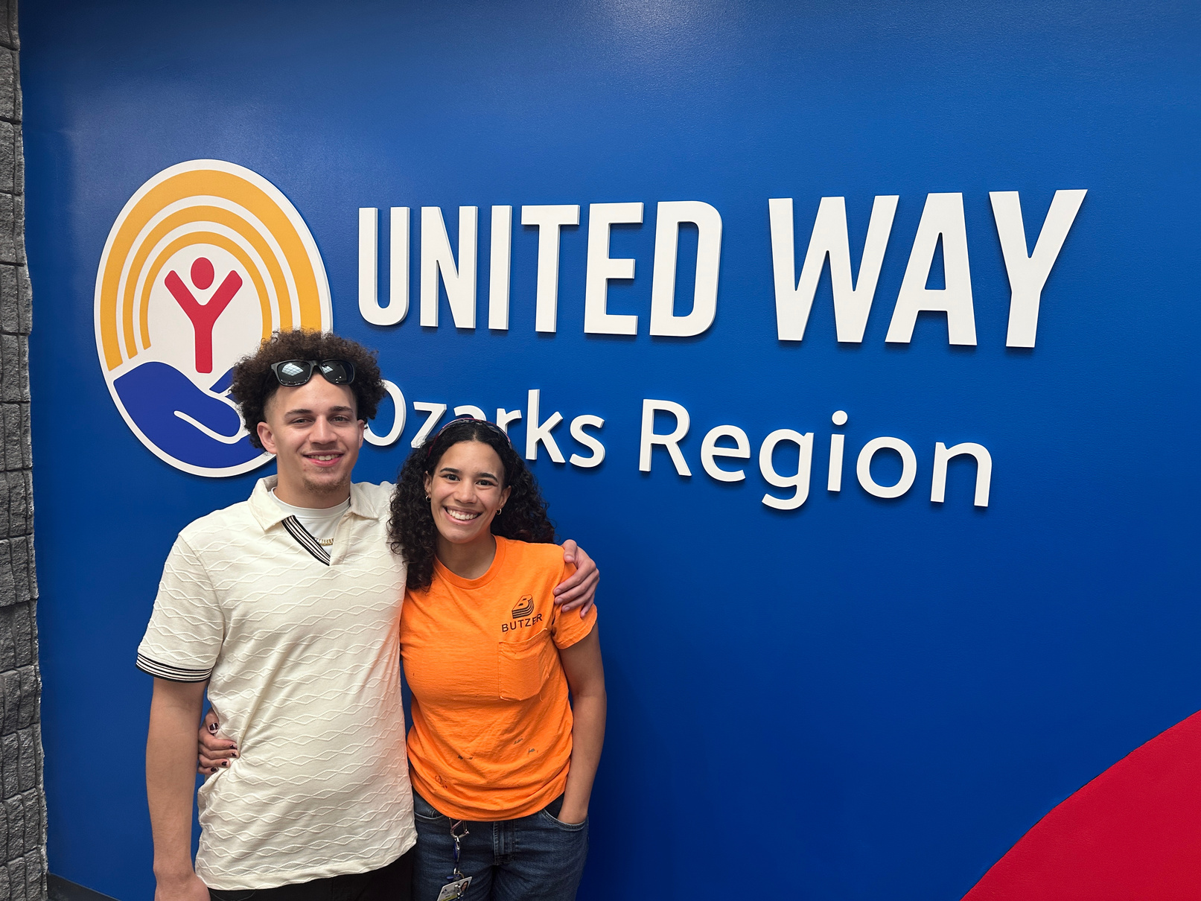
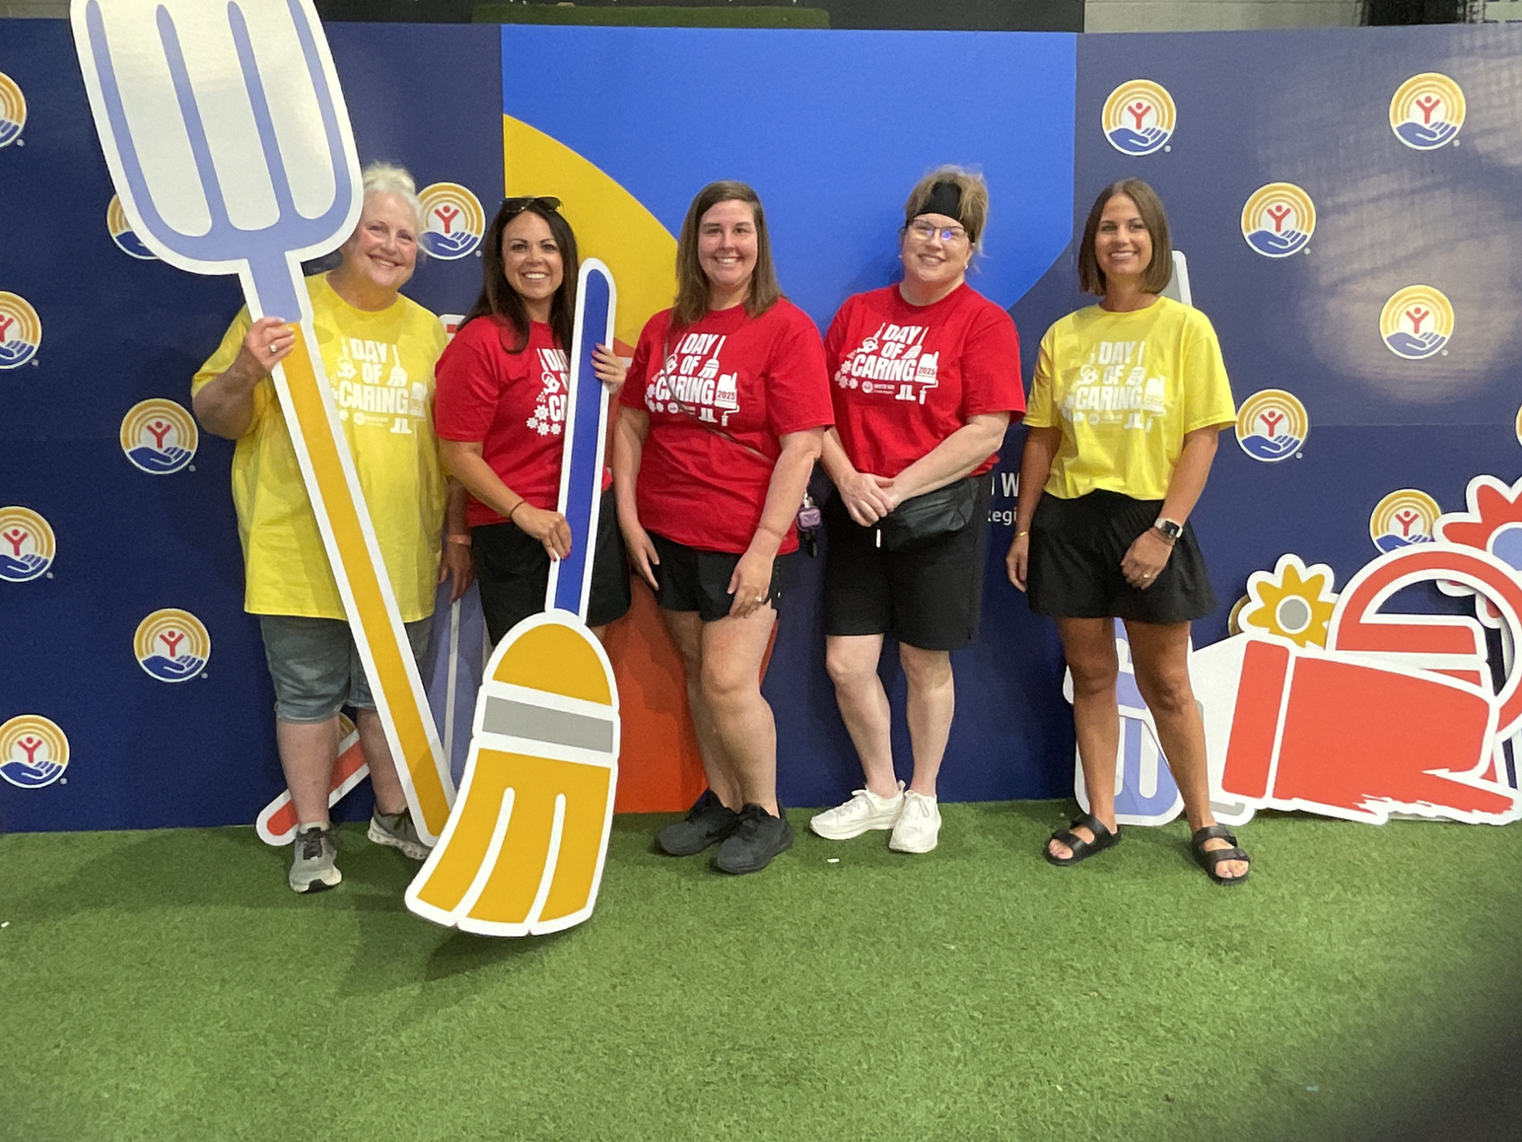
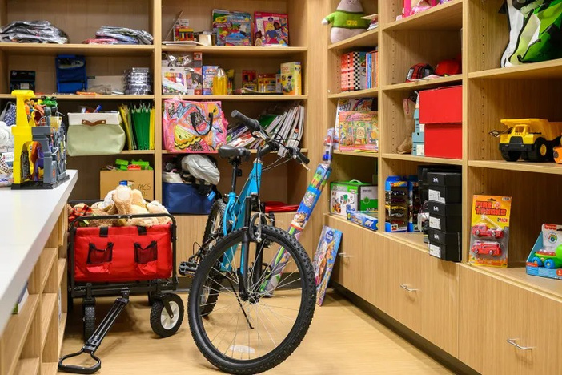
“I WAS HOPELESS AS HECK
BEFORE I FOUND THE PROGRAM.
MY QUALITY OF LIFE HAS BEEN
SIGNIFICANTLY GREATER”
TYLISHA LEATH - MWI GRADUATE
“I VOLUNTEER FOR UNITED WAY’S DAY OF CARING BECAUSE I KNOW FIRSTHAND HOW MUCH COMMUNITY SUPPORT MATTERS. GROWING UP IN POVERTY SHOWED ME THE DIFFERENCE COMPASSION AND ACCESS TO RESOURCES CAN MAKE IN A PERSON’S LIFE.”
BROOKLYN SOTO - JOHN DEERE REMAN
“THE CASA CLUBHOUSE HAS BEEN A WONDERFUL ASSET FOR ME AND MY KIDS. I AM LIVING IN MY CAR, SO BRINGING THEM A MEAL OR SHOWING UP CLEAN FOR OUR VISITS HAS BEEN CHALLENGING. THE CLUBHOUSE HAS ALLOWED ME TO TAKE CARE OF MY PERSONAL HYGIENE, DO MY LAUNDRY, COOK WITH THEM, AND SHOW UP IN A BETTER WAY WHEN GETTING TO SEE MY KIDS DURING OUR VISITS. WE HAVE SO MUCH FUN, AND MY KIDS ARE SAFE. IT HAS MADE A REAL DIFFERENCE IN KNOWING I AM ALSO SEEN AND SUPPORTED WHILE I AM HERE.”
LOCAL MOTHER & CASA CLUBHOUSE CLIENT

Slide 10


July 1, 2025 - June 30, 2026
9,047
calls received
TOP SERVICE REQUESTS
  Housing & Shelter
  Utilities
  Transportation Assistance
  Food
UNITED IS
THE WAY.
‹#›
Notes:
6

Slide 11
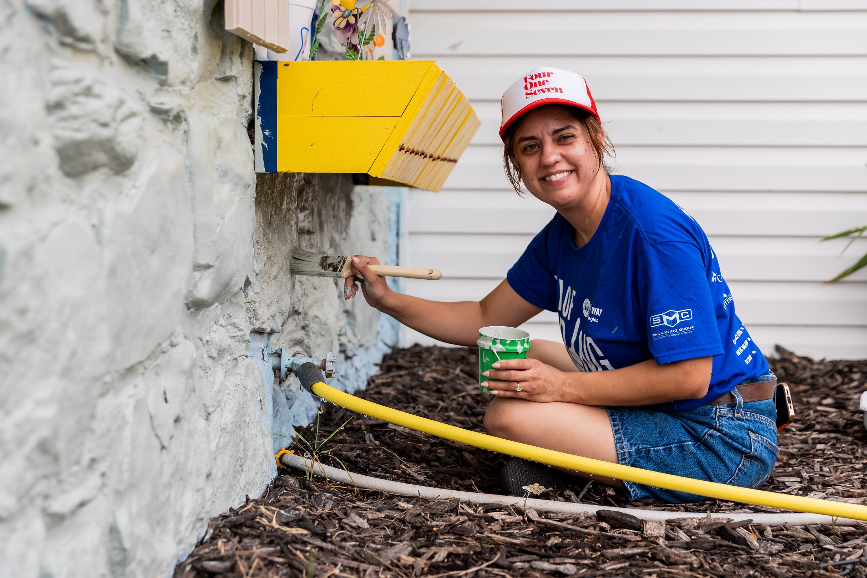
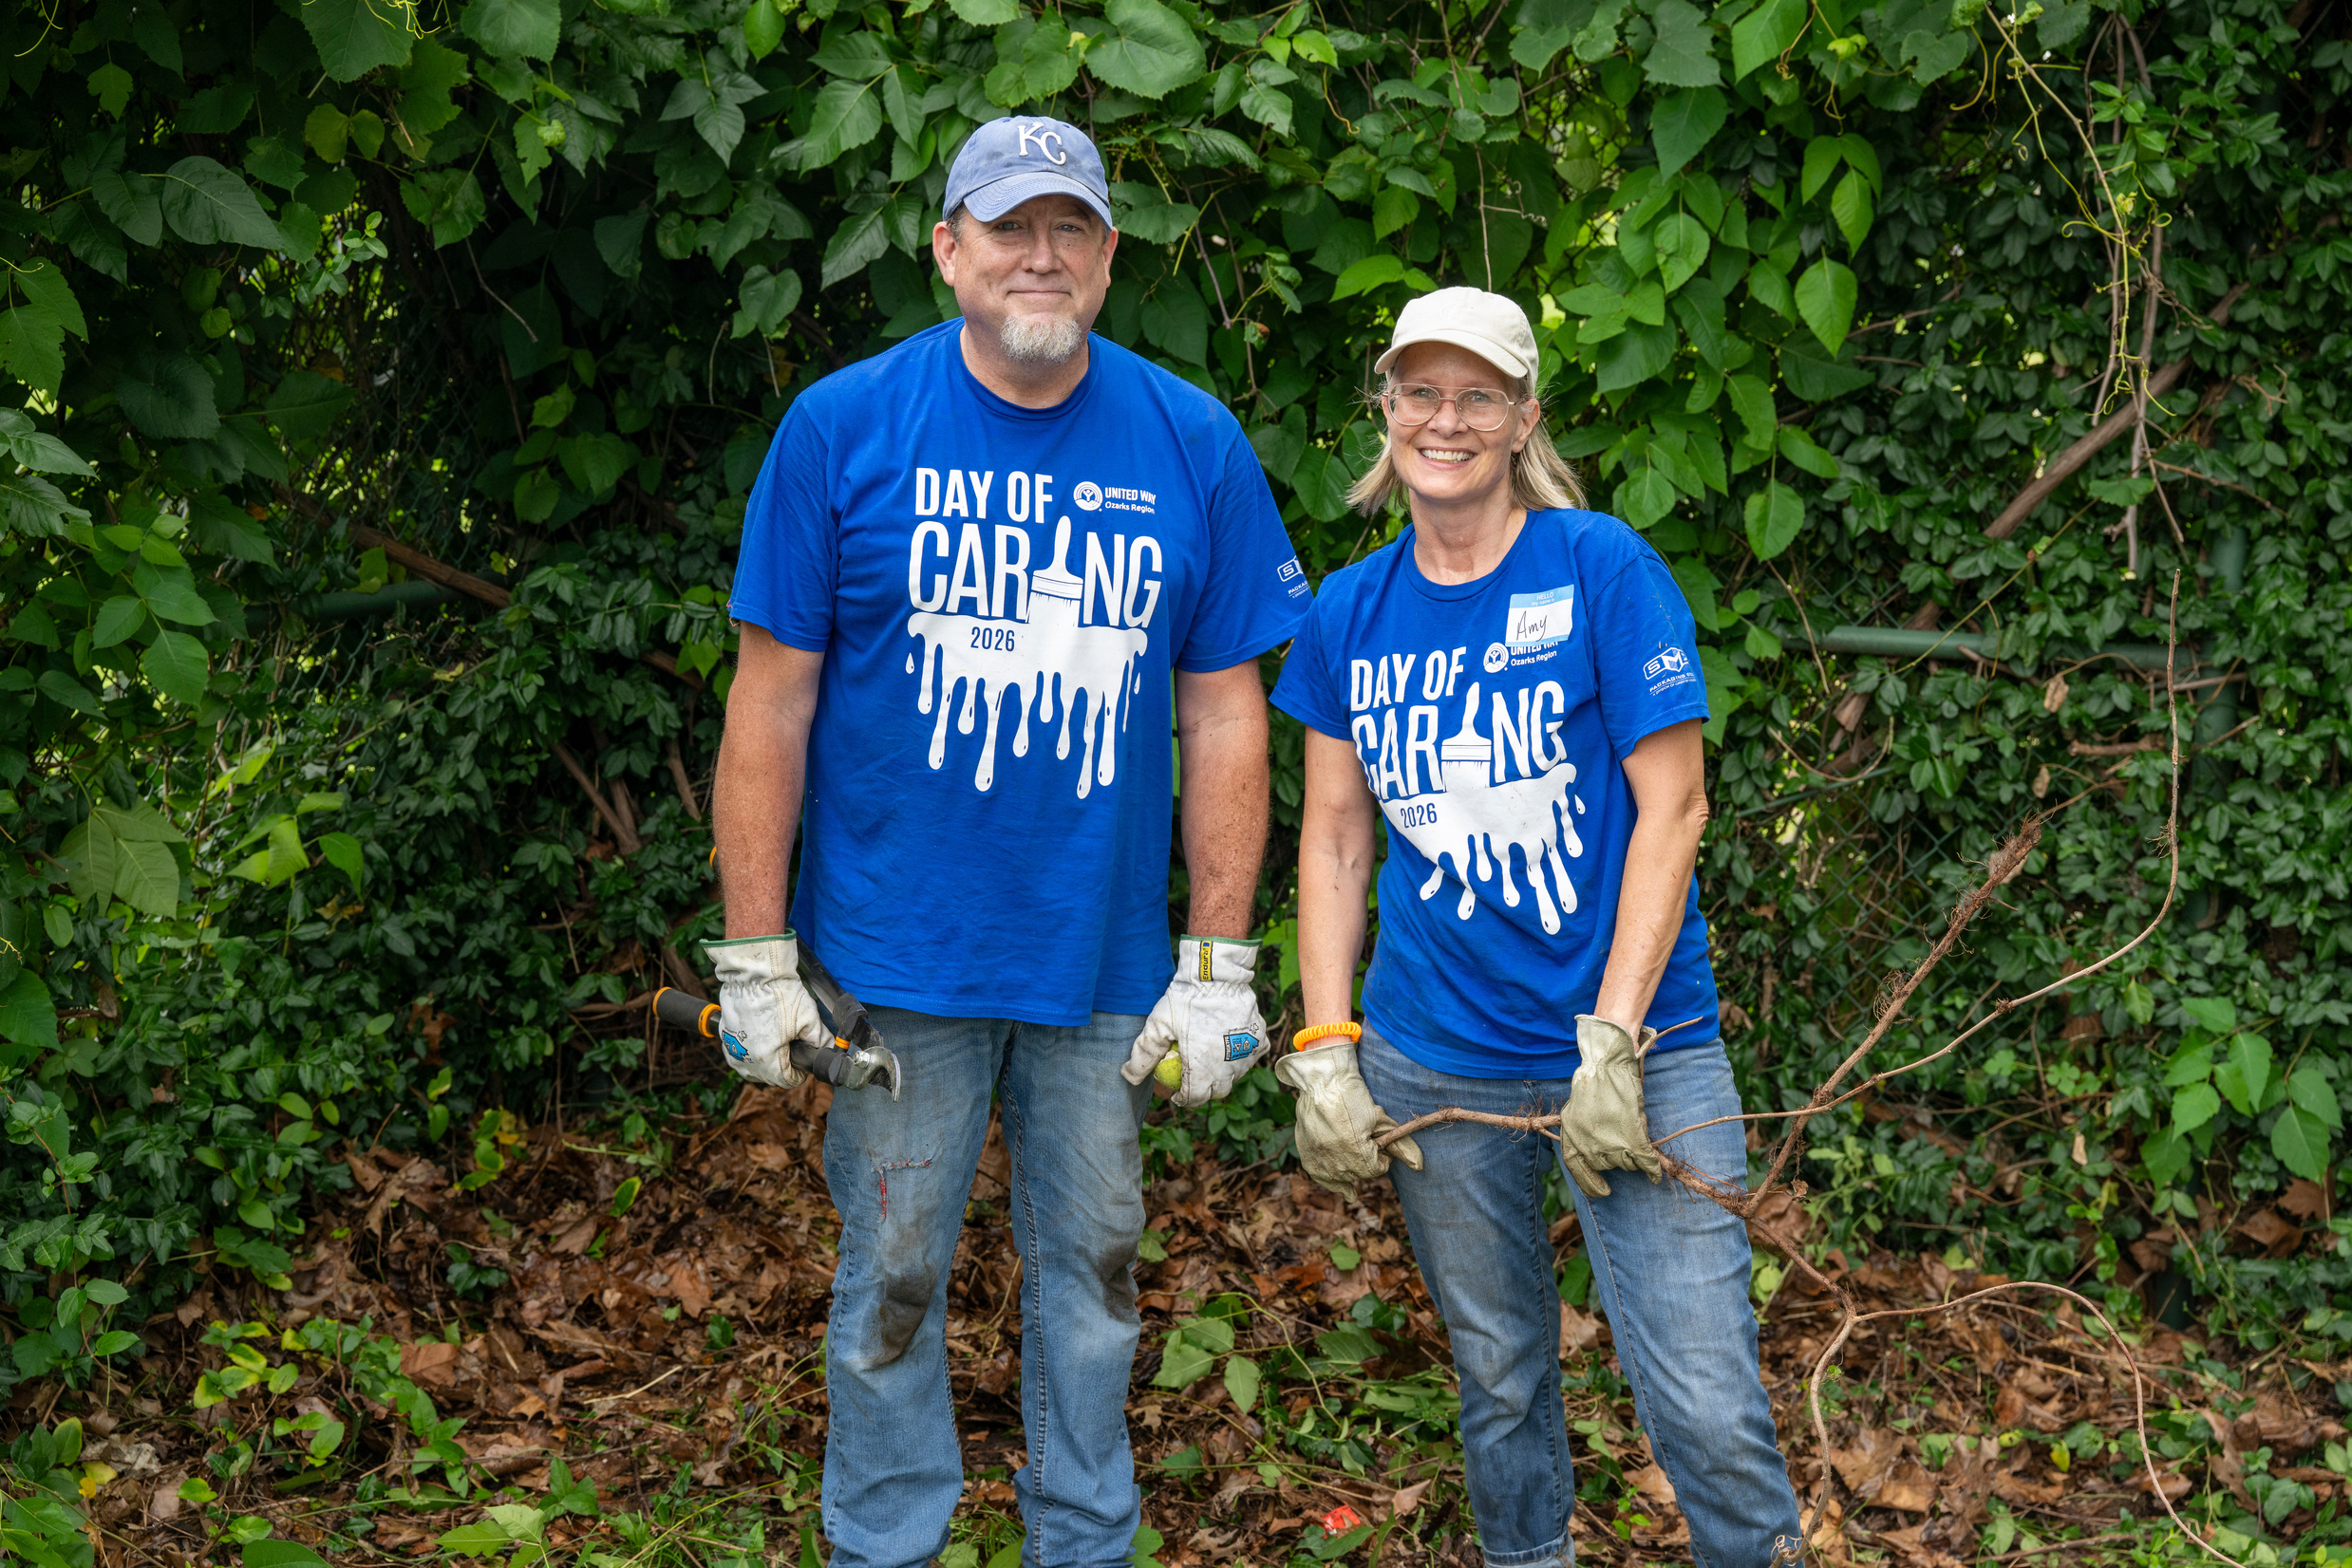
DAY OF CARING
1,300+ VOLUNTEERS
donated 5,225 hours valued at
$188,850
to complete
114 PROJECTS
54 NONPROFITS
@
UNITED IS
THE WAY.
Notes:
6

Slide 12

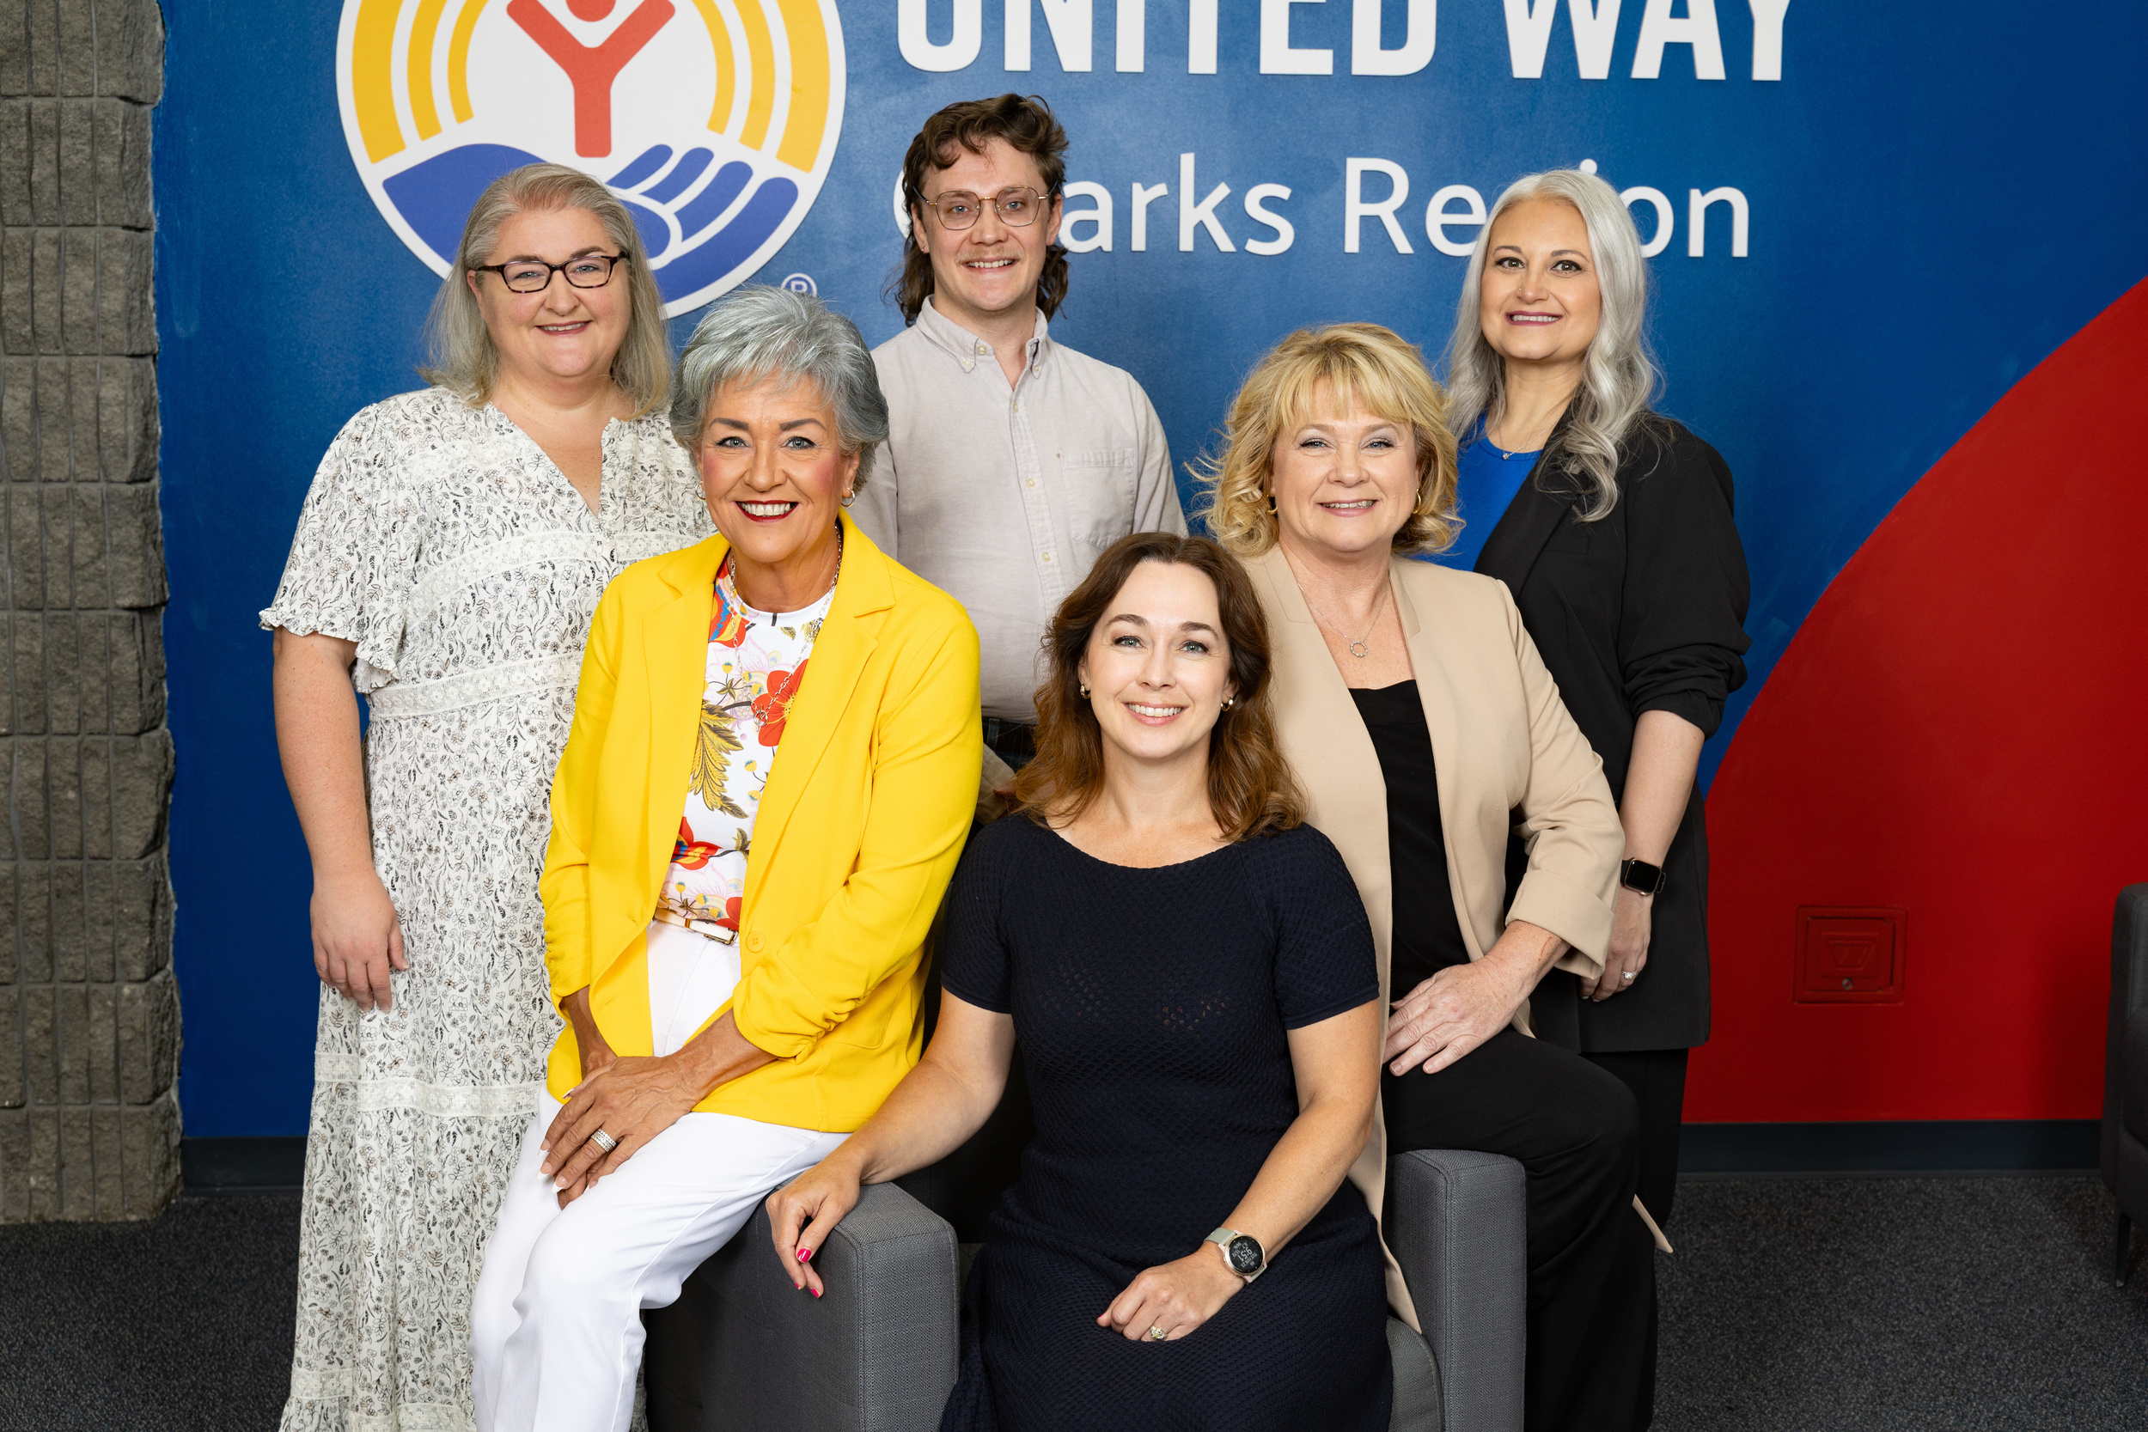
THANK
YOU!
320 N Jefferson Ave
417-863-7700
liveunited@uwozarks.org
Notes:
Special note: our CEO, Brandi VanAntwerp, serves on the CU advisory Committee

