Slide 1
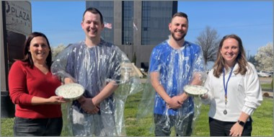
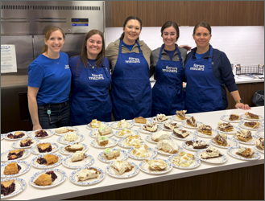

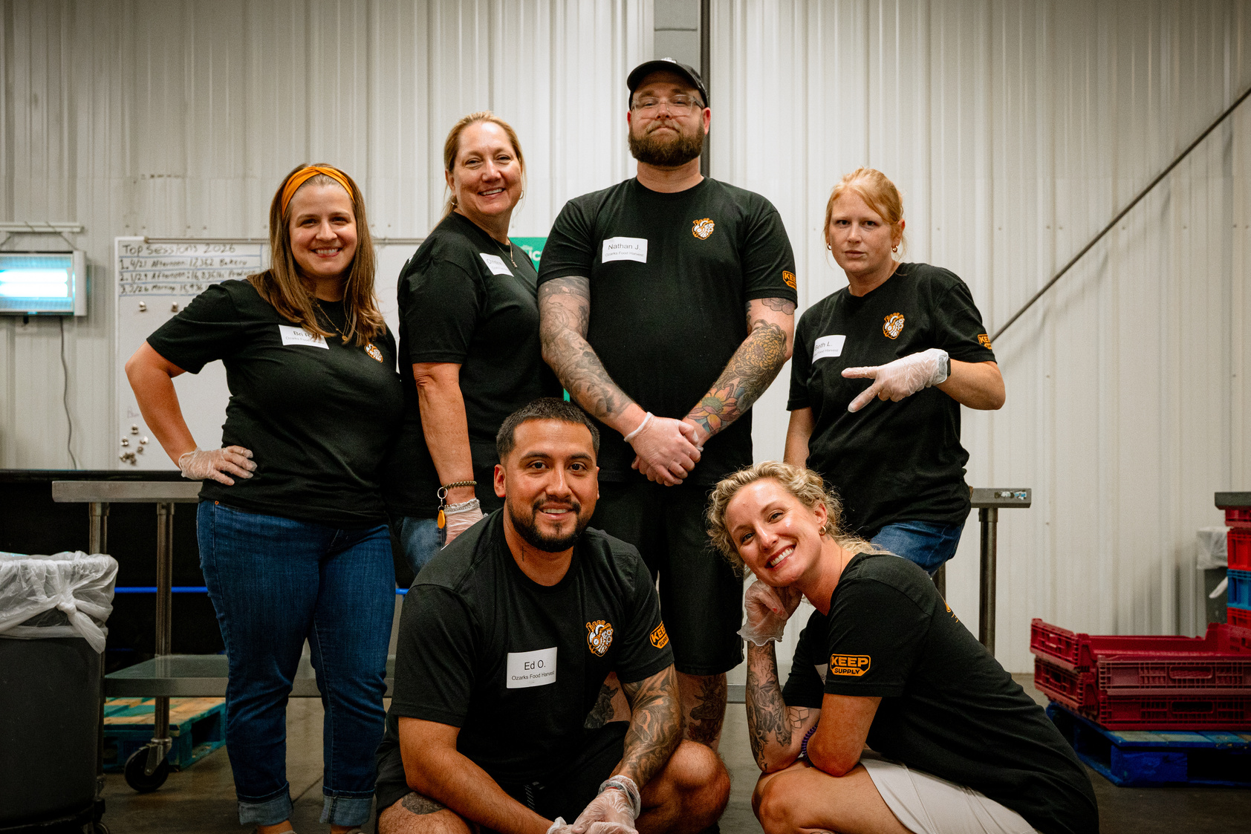
2026
EMPLOYEE CAMPAIGN MANAGER TRAINING
UNITED IS
THE WAY.
Notes:
11:30 start time

Slide 2


BROUGHT TO YOU BY
UNITED IS
THE WAY.
Notes:
Brandi

Slide 3
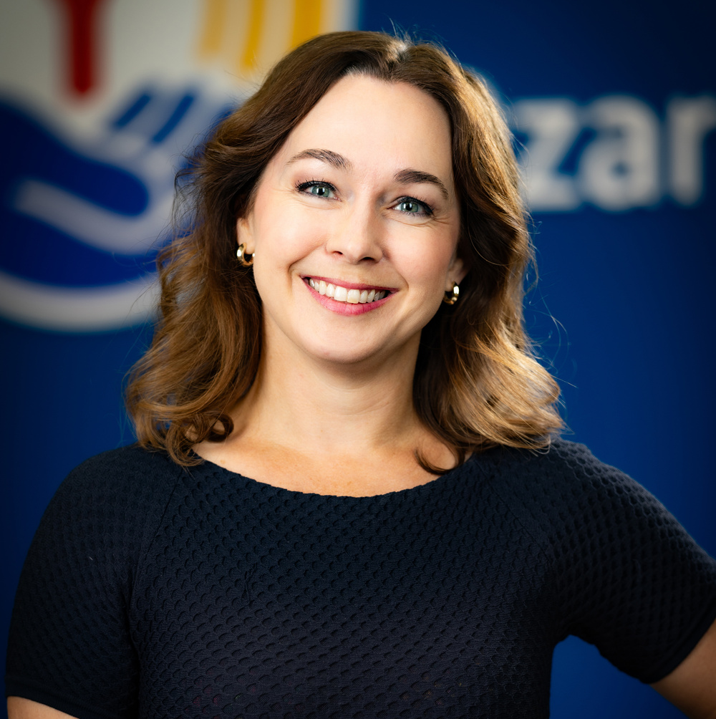
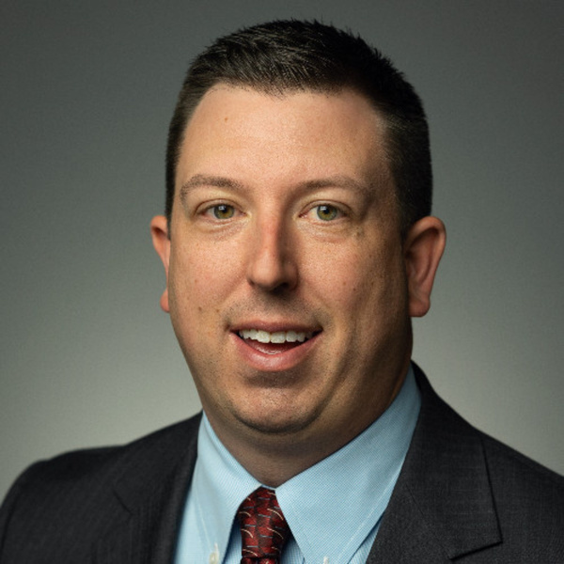
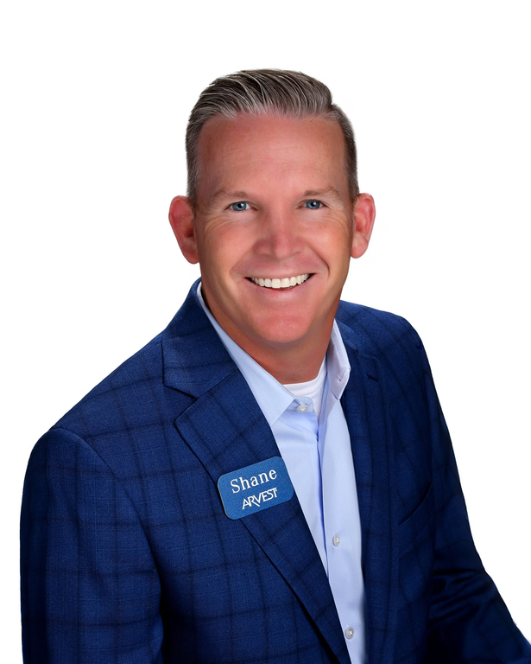

WELCOME & INTRODUCTIONS
BRANDI VANANTWERP
RYAN SIVILL
SHANE COWGER
PRESIDENT/CEO
UNITED WAY OZARKS REGION
UWO BOARD CHAIR
PARTNER, FORVIS MAZARS
UWO BOARD MEMBER
PRESIDENT, ARVEST BANK - SPRINGFIELD
Tell us your name, company & how long you have been an Employee Campaign Manager
UNITED IS
THE WAY.
Notes:
11:40-11:50 Brandi
• Welcome by Brandi & Ryan Sivill
• Brandi introduce Board member & Sponsor, Shane Cowger, Arvest Bank
• Brandi ask that everyone does a short around the room Introductions (name & how long have you been the ECM)

Slide 4
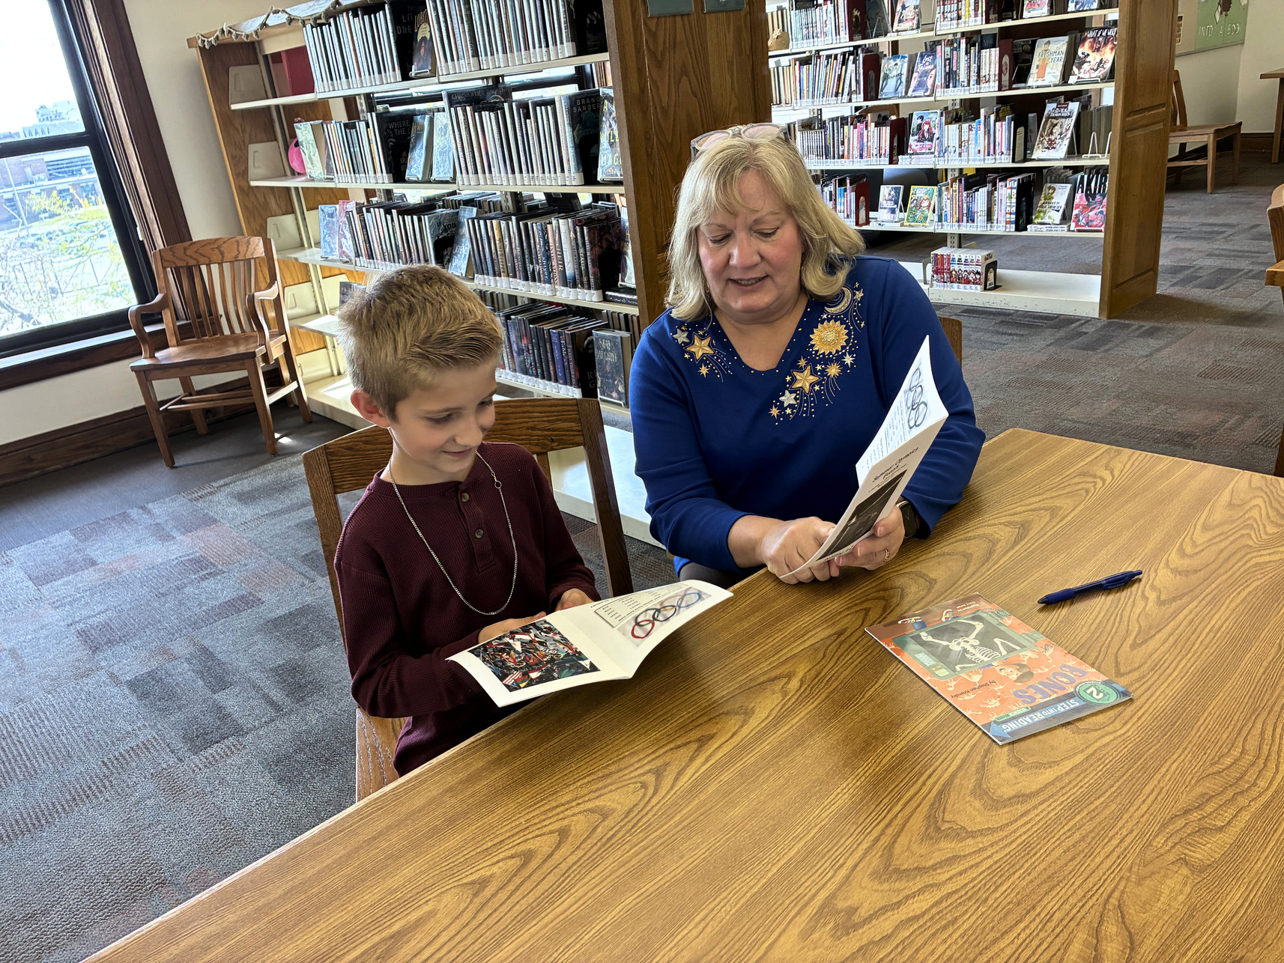
FOCUS AND FUNDING
Notes:
11:50-12:00 Brandi

Slide 5
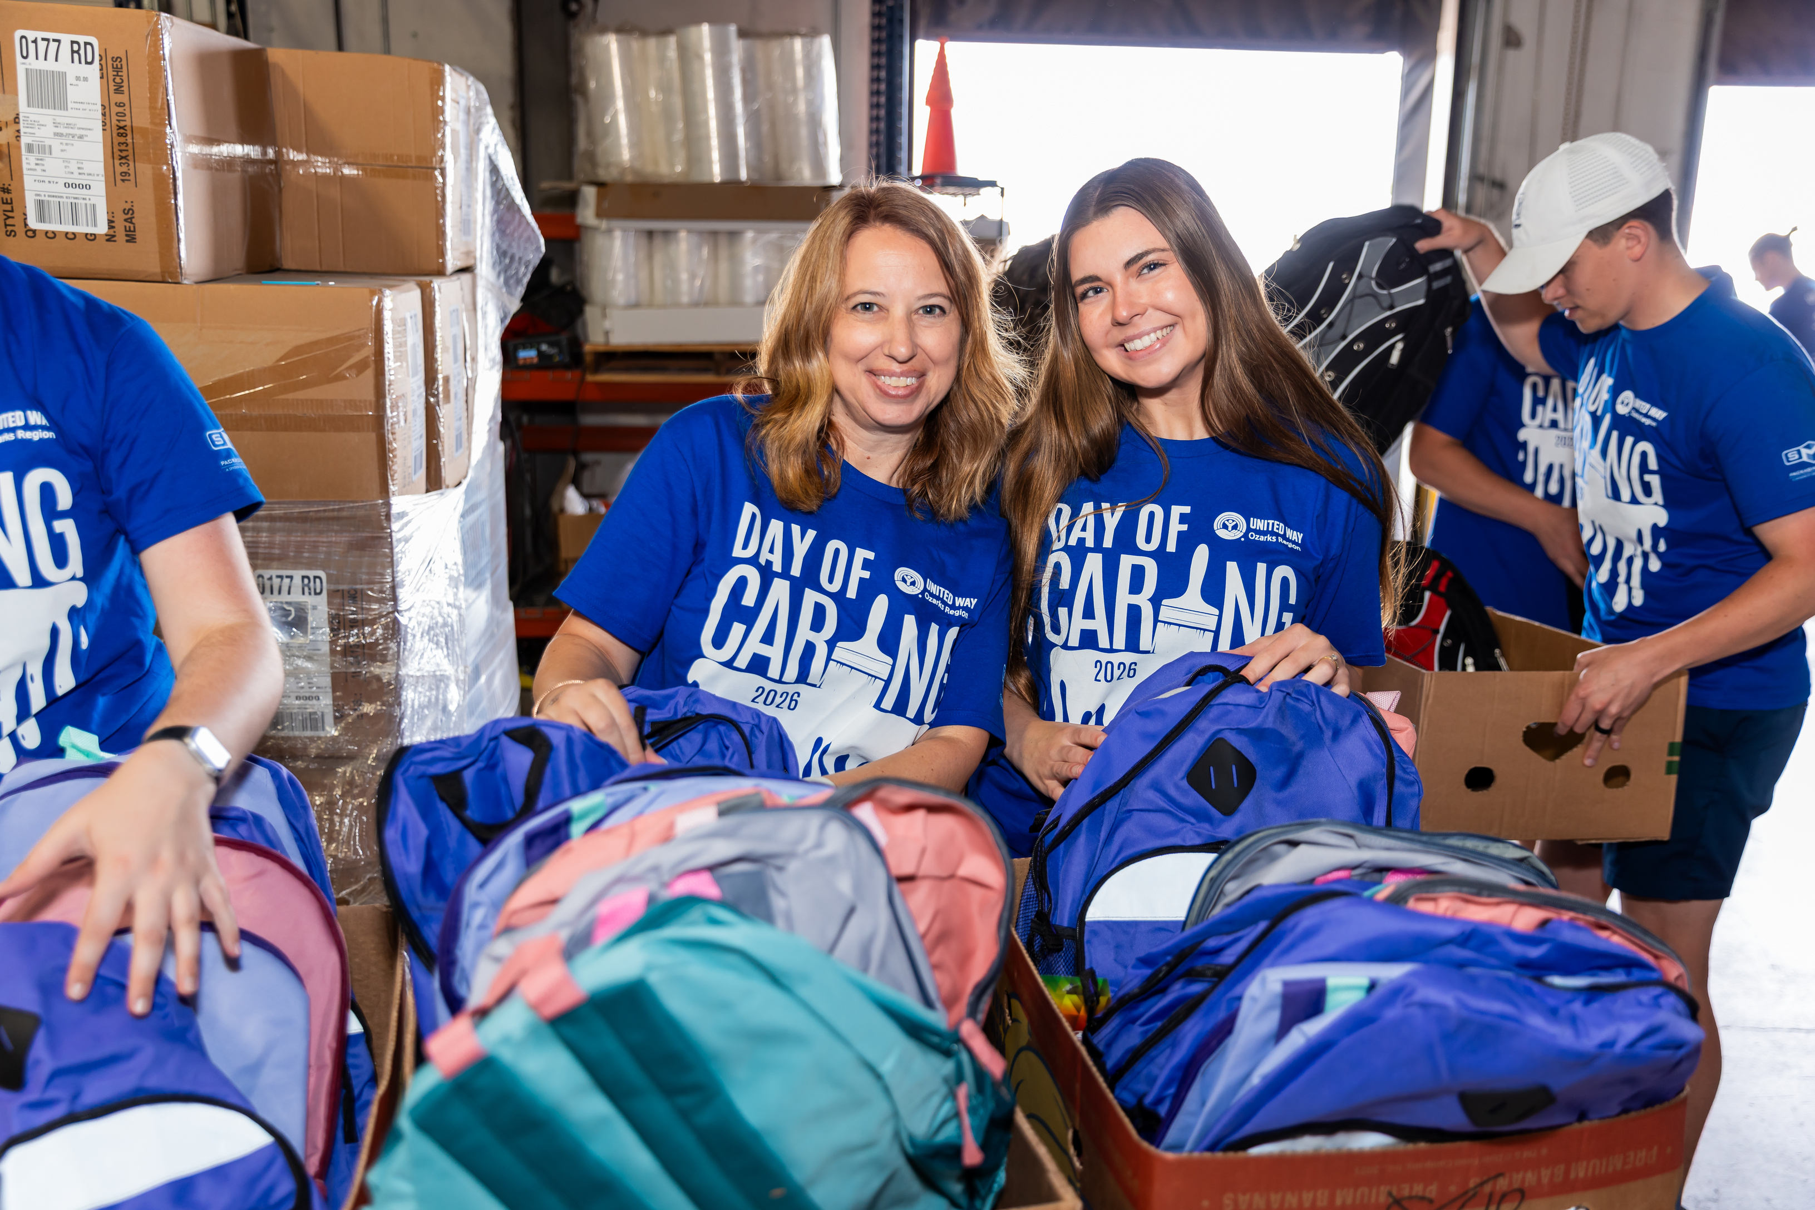
UNITED IS
THE WAY.
OUR MISSION
United Way Ozarks Region unites people, resources and ideas to enhance lives in the Ozarks.
OUR VALUES
Accountability. Collaboration. Impact. Inclusivity.
Notes:
Brandi

Slide 6
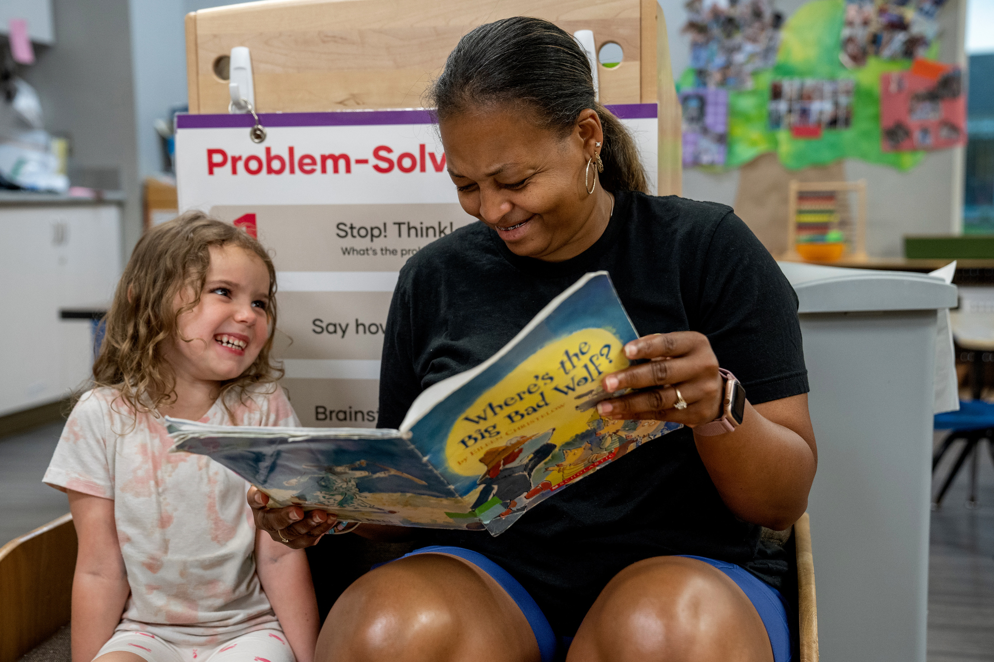
CHAMPIONING CHILDREN
Ensuring our community’s children reach their full potential, by achieving milestones in development, education and health.
UNITED IS
THE WAY.
Notes:
Brandi

Slide 7
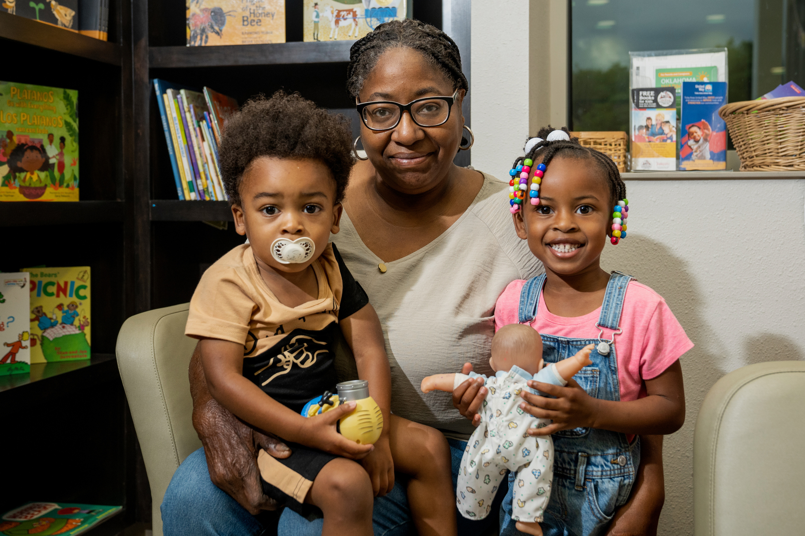
UNITED IS
THE WAY.
PATHWAYS OUT
OF POVERTY
Helping people build brighter futures through stable housing, workforce readiness and financial literacy.
Notes:
Brandi

Slide 8


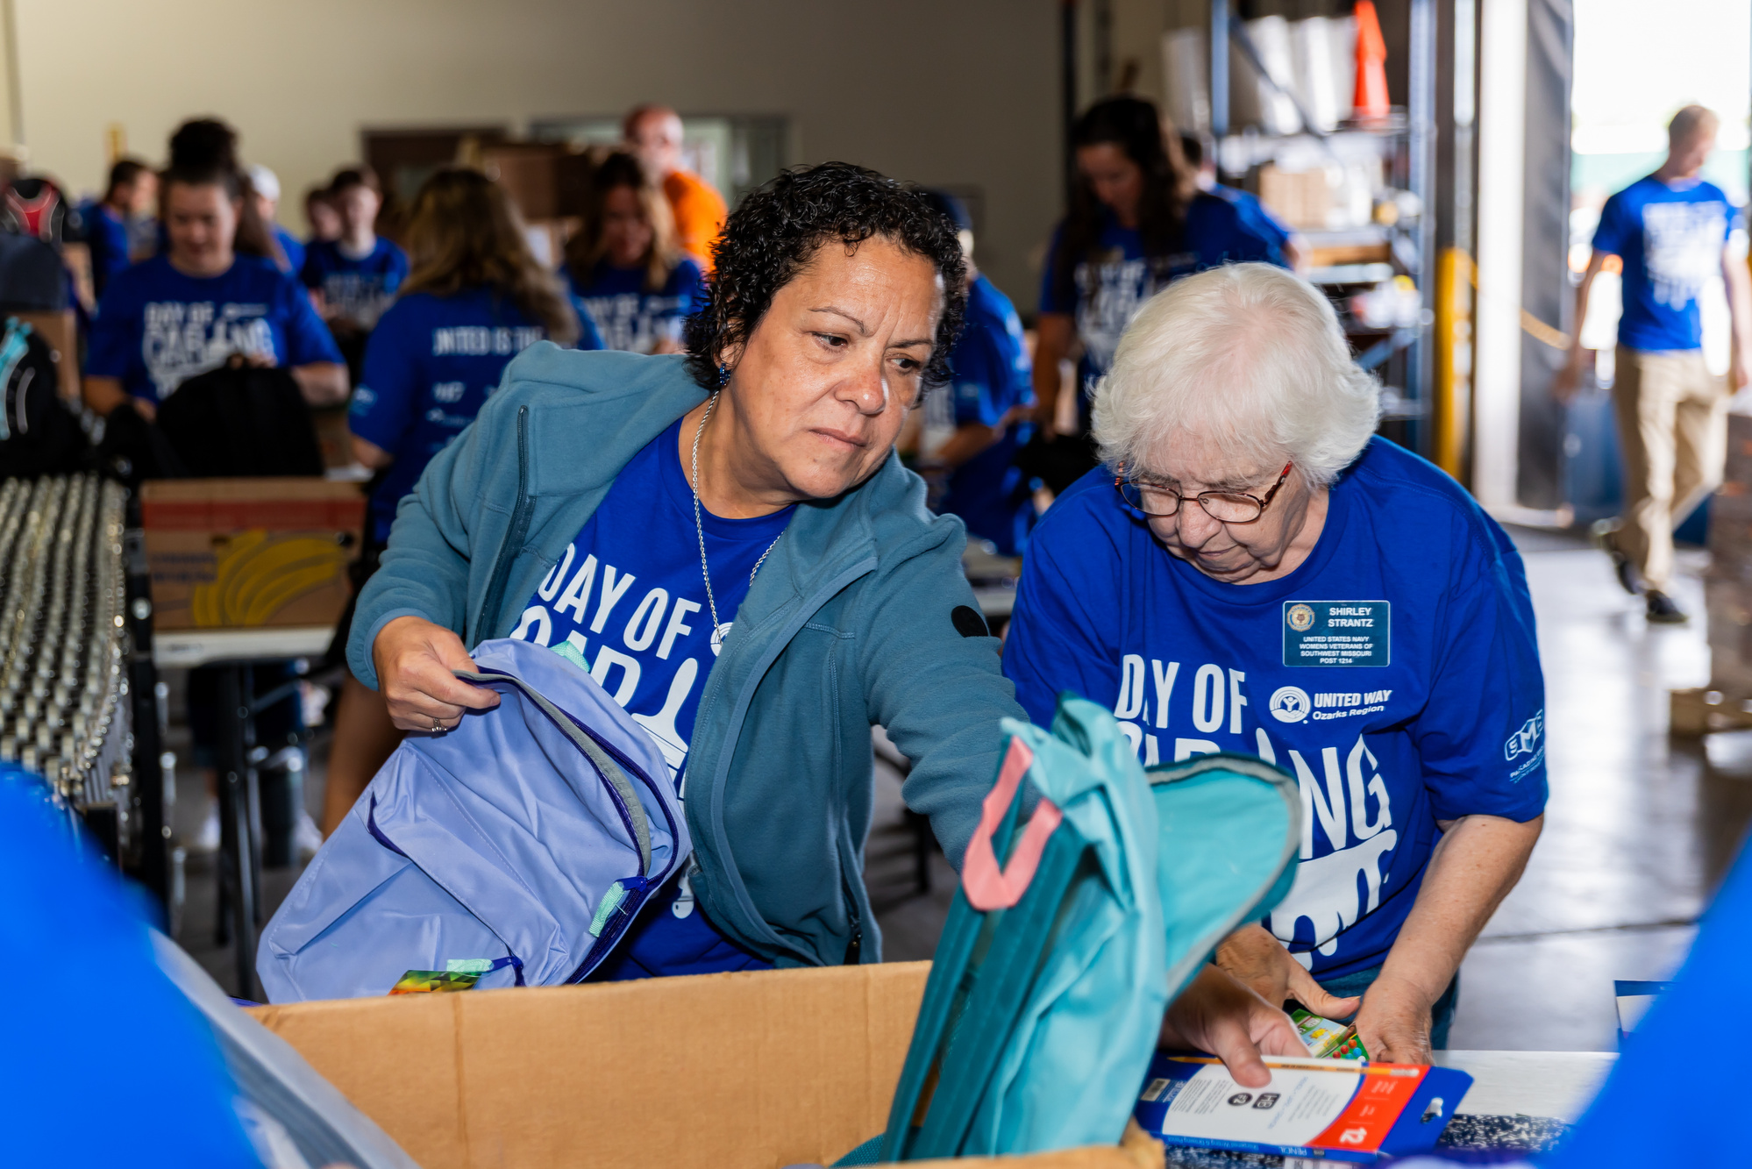
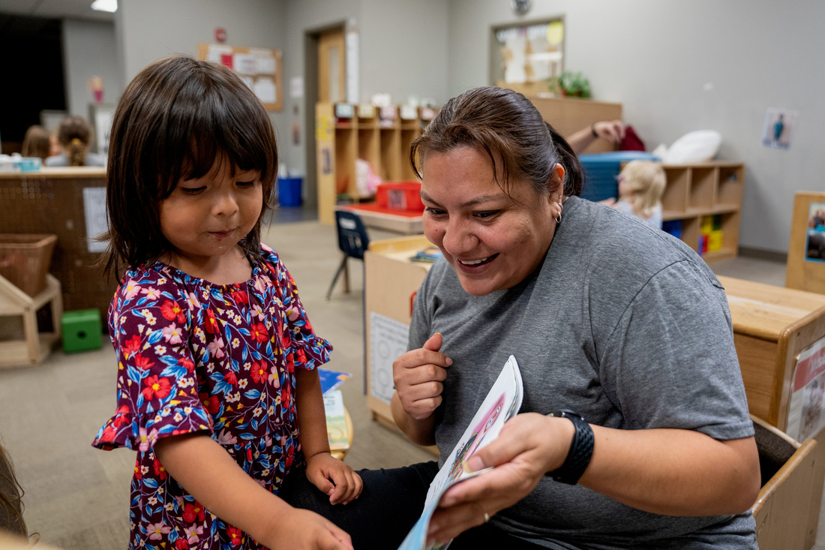
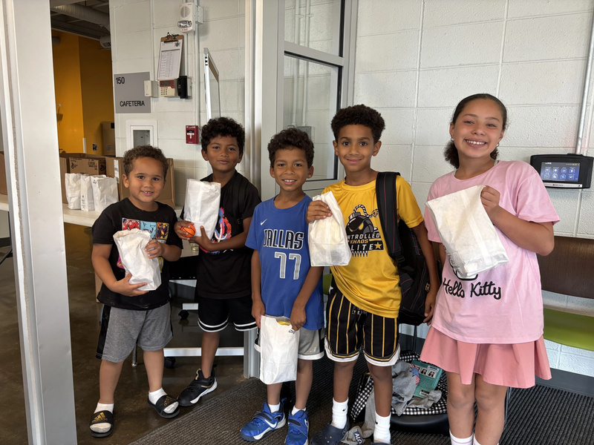
YOUR IMPACT
41,126
TOTAL LIVES IMPACTED
July 2025 - June 2026
4,371
PEOPLE SERVED THROUGH FOOD & NUTRITIION ASSISTANCE PROGRAMS
20,249
FAMILIES SERVED WITH CHILD DEVELOPMENT SUPPORTS
11,453
STUDENTS SERVED THROUGH OUT-OF-SCHOOL SUPPORTS
Notes:
Brandi

Slide 9














Access to Mental Healthcare
Parental Mental Health Wellness and Skills Enhancement Program
Community-Based One-on-one Mentoring
Shape-up Program
CASA Clubhouse Child Advocacy
PRIORITY PARTNER
19 FUNDED PROGRAMS AT 14 PARTNER NONPROFITS
Forensic Services Protecting Our Youth
Math and Reading Buddy Program
O’Reilly Center for Hope
Pediatric Therapies
New Pathways for Good Dads
Community Outreach Program Emergency Shelter
Ozarks Family Resource Center
Counseling and Education
Crisis Intervention and Advocacy
Weekend Backpack Program
Reading Tutoring
Notes:
Brandi

Slide 10
COMMUNITY INVESTMENT FUND
THE MOST POWERFUL WAY TO IMPACT YOUR COMMUNITY
WHEN YOU GIVE THROUGH UNITED WAY, WE IMPROVE
MORE LIVES IN MORE WAYS THAN ANY SINGLE AGENCY CAN.
  Allocations, based on undesignated dollars, are determined by a panel of donor volunteers
  Identifies gaps and reduces duplication of services
  Investment is made where the need is greatest
  Programs are effective and financially stable
Notes:
Brandi

Slide 11
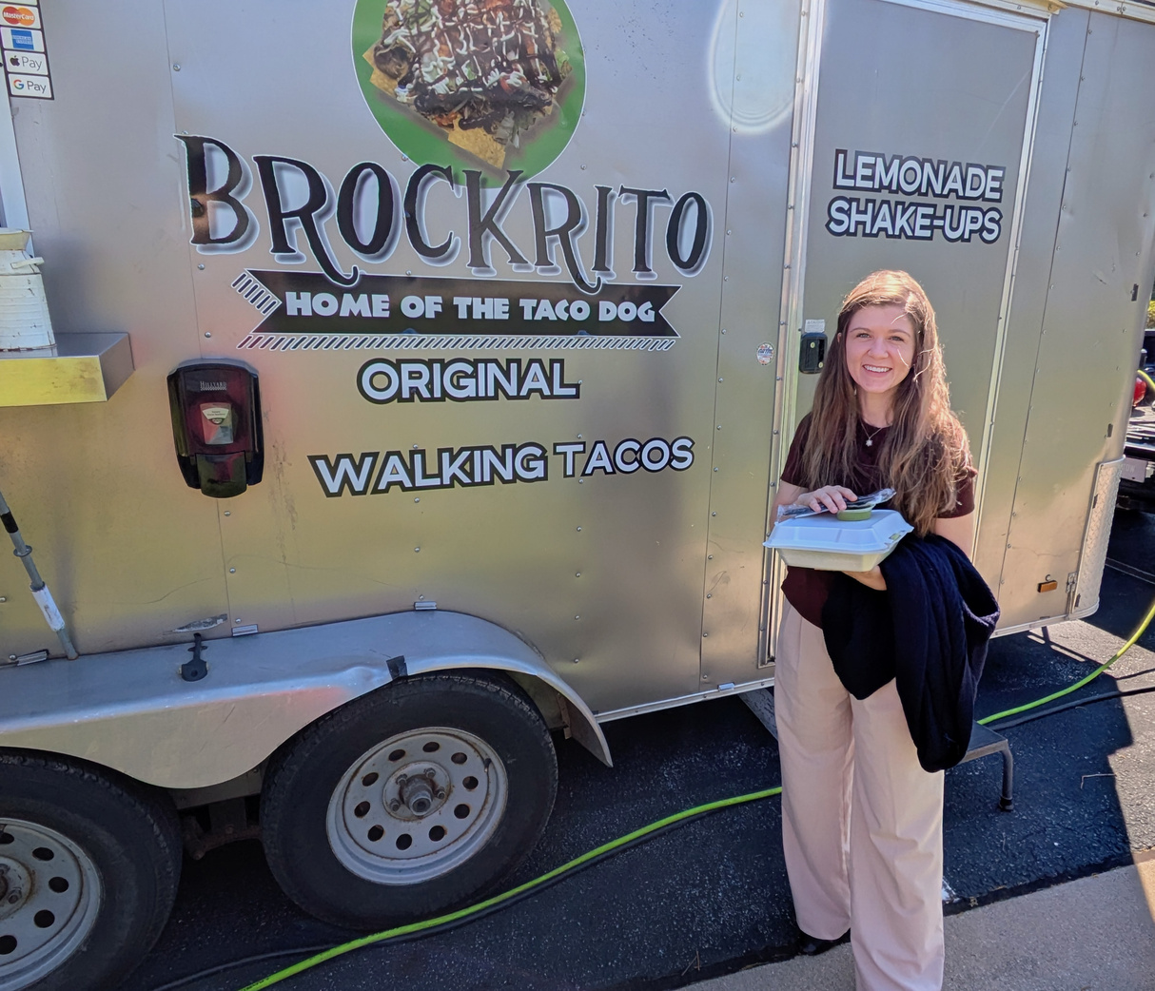
ECM ROLE/TOOLS FOR SUCCESS
Notes:
12:00-12:15
Brandon & Tranna

Slide 12


2026-2027
CAMPAIGN
OUR GOAL:
$1.8 MILLION
Notes:
12:00 Tranna
Share that the theme this year is again United is the Way with a goal to raise 1.8mil

Slide 13

CHAMPIONING UNITED WAY
YOUR ROLE AS AN EMPLOYEE CAMPAIGN MANAGER
  Get invested!
  Create a culture of giving
  Fun engagement
UNITED IS
THE WAY.
Notes:
12:00
Tranna-5 min
Share with them why they are the "cheerleaders" of United Way and the importance of them getting invested, creating a culture of giving and fun engagement.

Slide 14
CHAMPIONING UNITED WAY
STEPS TO A SUCCESSFUL WORKPLACE CAMPAIGN
Resource Library
Notes:
12:05-12:15 Brandon
10 min
Please open the Steps to Success part and quickly go through it as well as the resource library
They have folders at their seat with a lot of this info in it
ECM NEXT STEP: fill out campaign participation survey or better yet, meet with account manager in person!

Slide 15
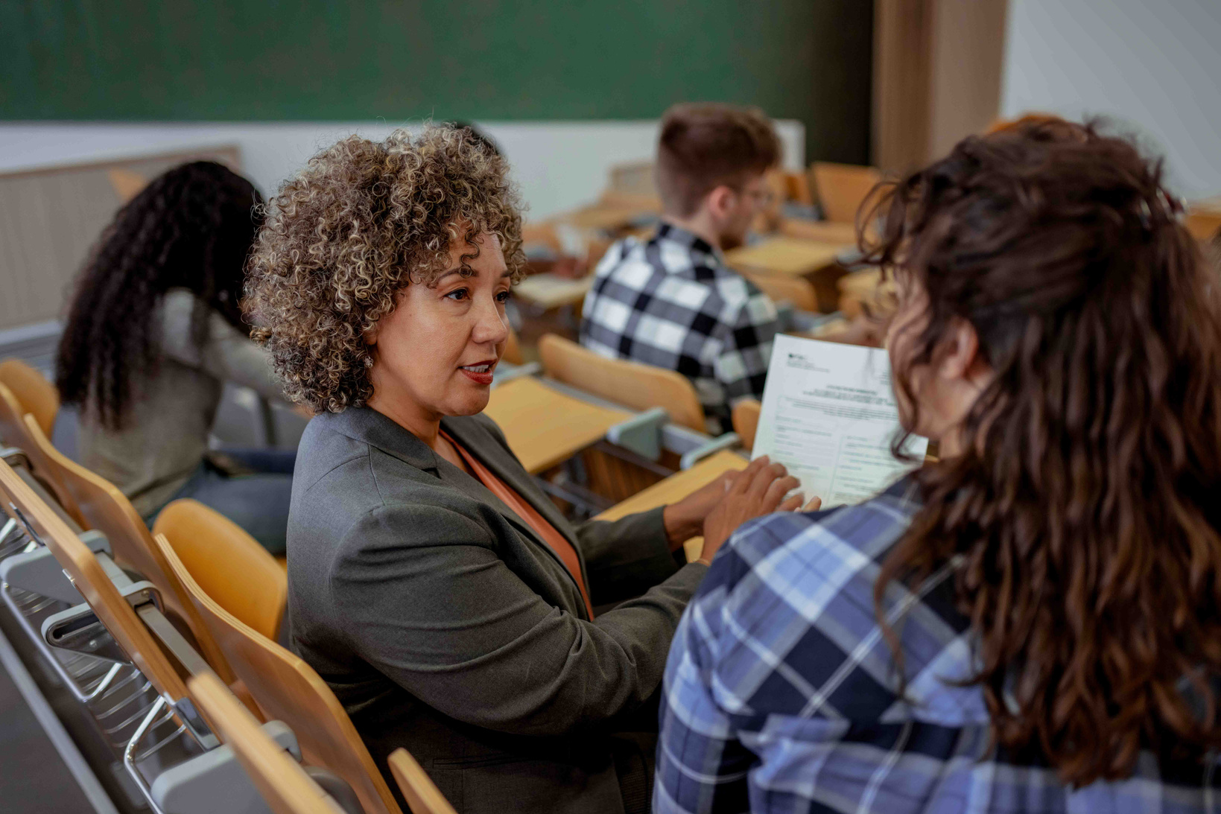
ECM PANEL DISCUSSION
Notes:
12:20-12:50 Janelle & Bill

Slide 16
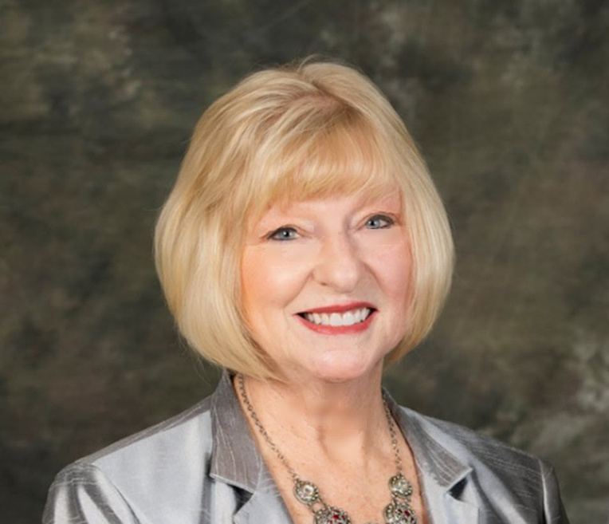
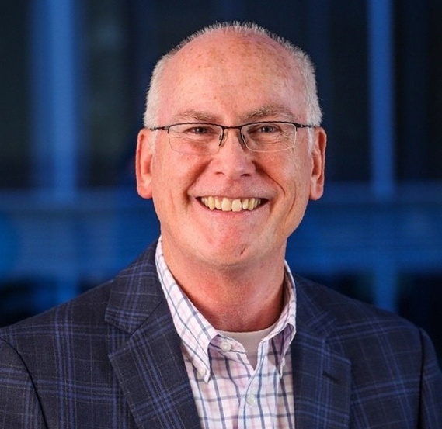
CAMPAIGN CABINET
CO-CHAIRS
DR. JULIE MASTERSON
RETIRED - MSU
BILL HENNESSEY
SPRINGFIELD CATHOLIC SCHOOLS
Notes:
12:20 Janelle
Intro Bill

Slide 17
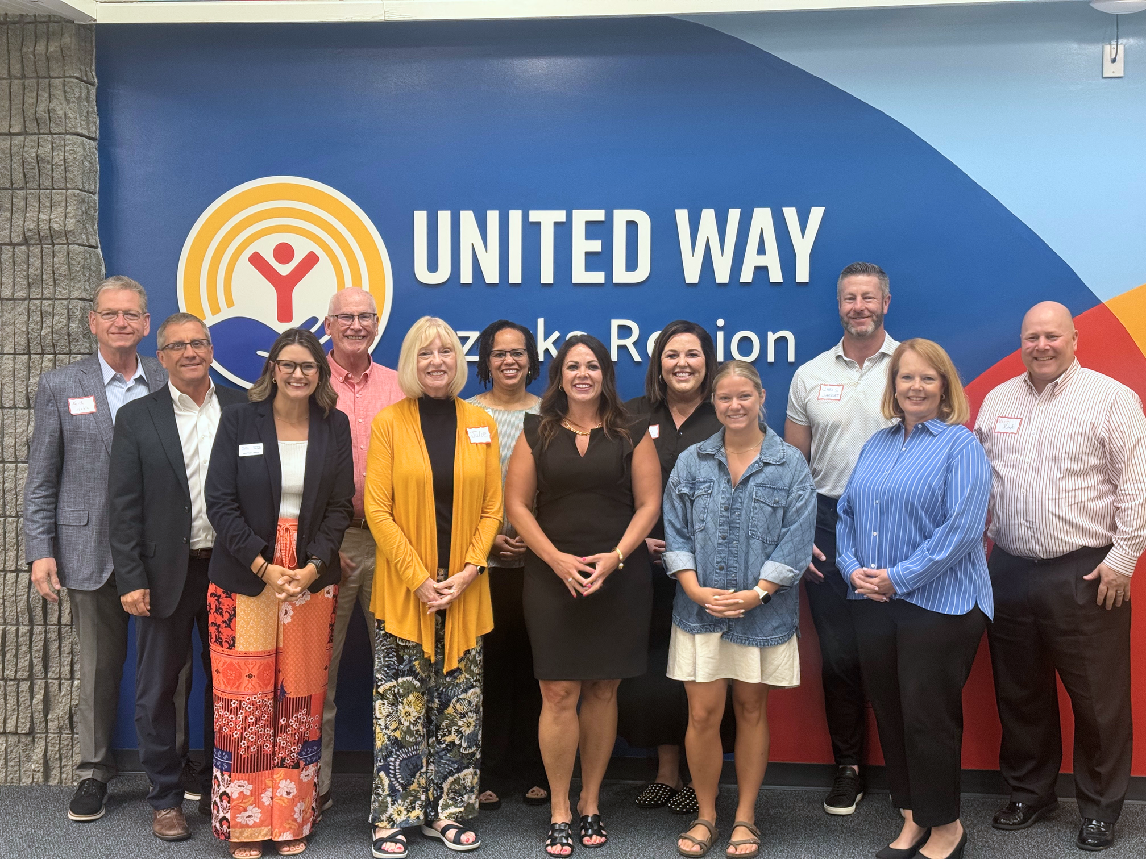
2026-2027 CAMPAIGN CABINET
  SARAH BECKLEY - TRANSLAND
  BECKY CONROY - WESTWARD ALLIANCE
  JASON FINKE - ASSOCIATED ELECTRIC
  JANELLE HAIK - MERCY FOUNDATION
  BILL HENNESSEY, CO-CHAIR - SPRINGFIELD CATHOLIC SCHOOLS
  SANDY HOWARD - RETIRED
  CHRIS JARRATT - REVEL ADVERTISING
  KEVIN KROPF - DRURY UNIVERSITY
  WHITNEY MANN - CITY UTILITIES
  DR. JULIE MASTERSON - CO-CHAIR - RETIRED
  KEITH NOBLE - COMMERCE BANK
  HEATHER PARKER - CITY OF SPRINGFIELD
  CLARENDA PHILLIPS - MISSOURI STATE UNIVERSITY
  ANTHONY ROBERTS - COMMUNITY BLOOD CENTER OF THE OZARKS
UNITED IS
THE WAY.
Notes:
12:20 Janelle
Show rest of cabinet

Slide 18
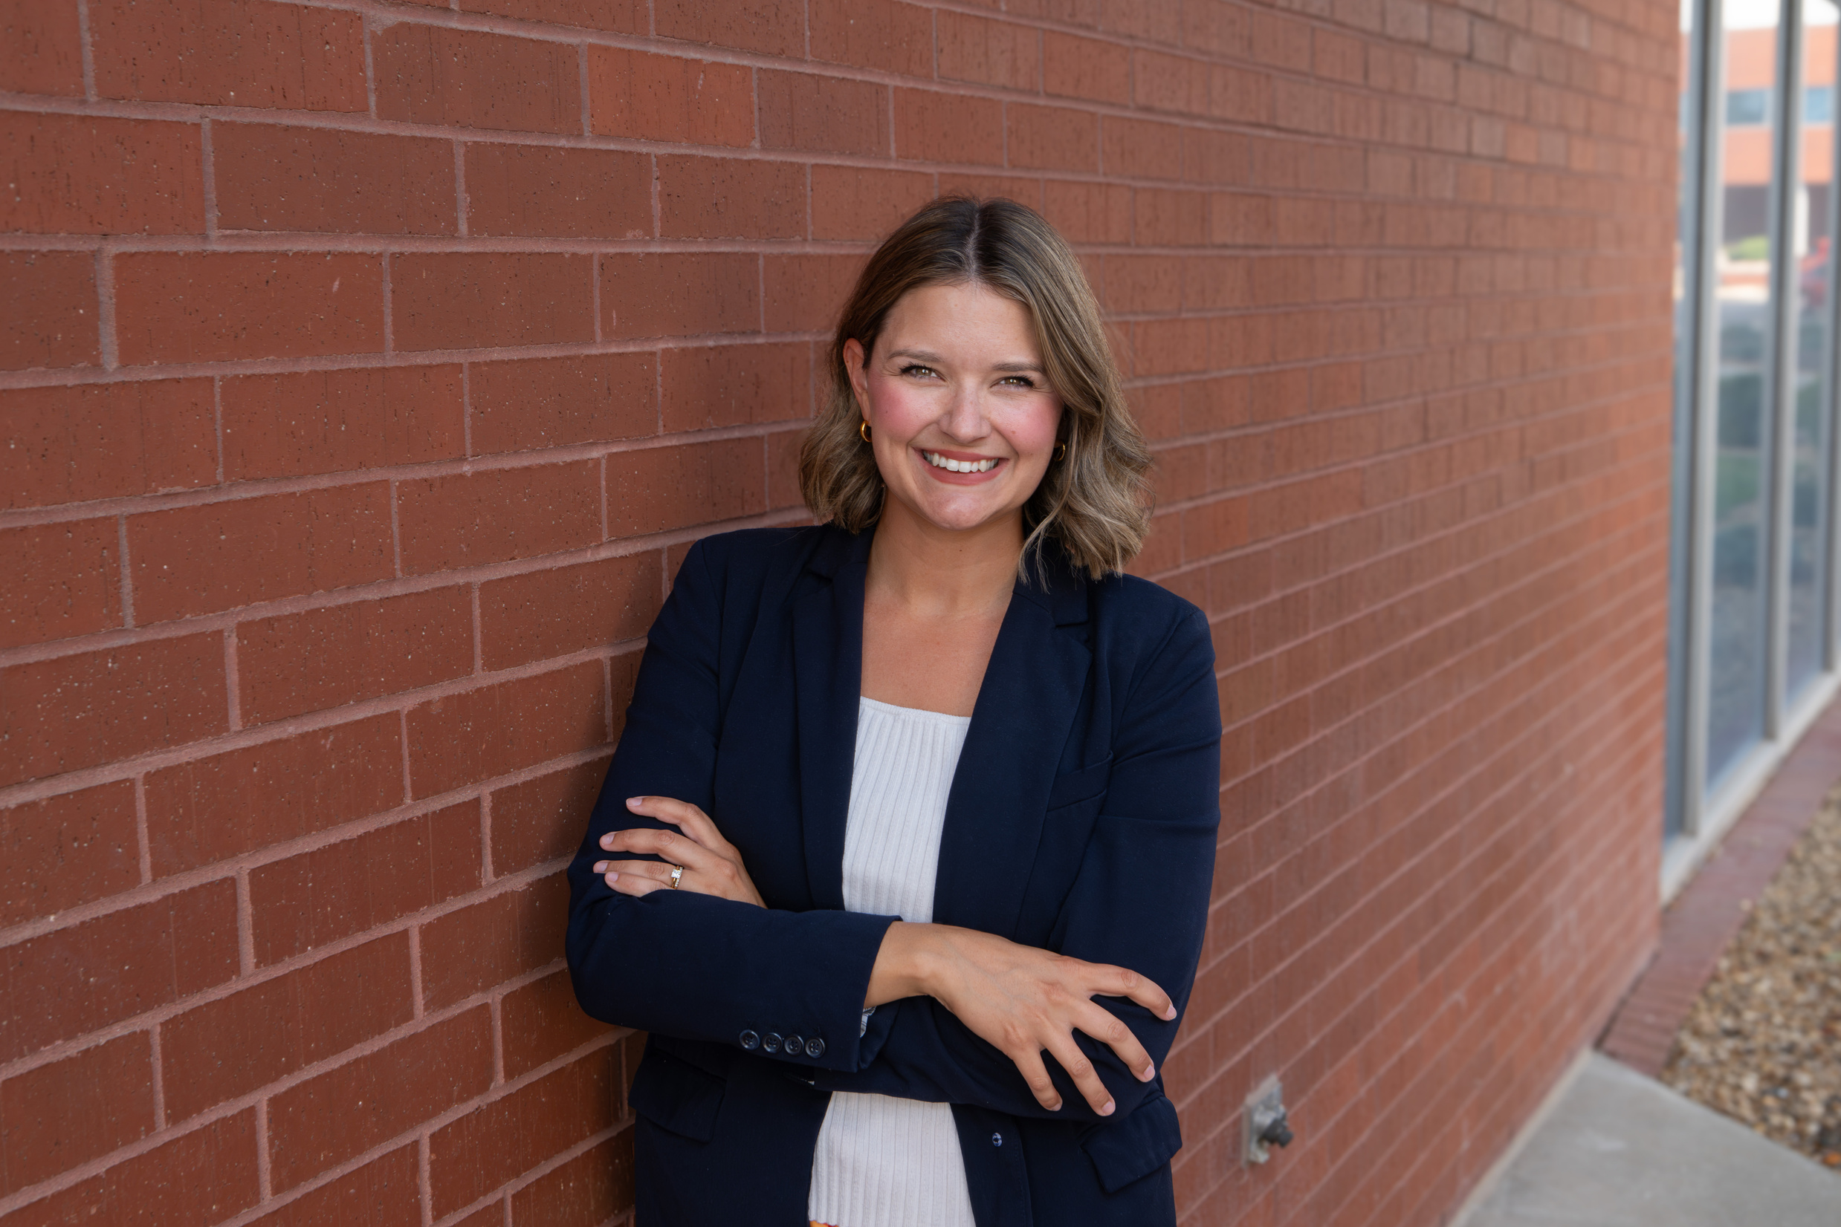
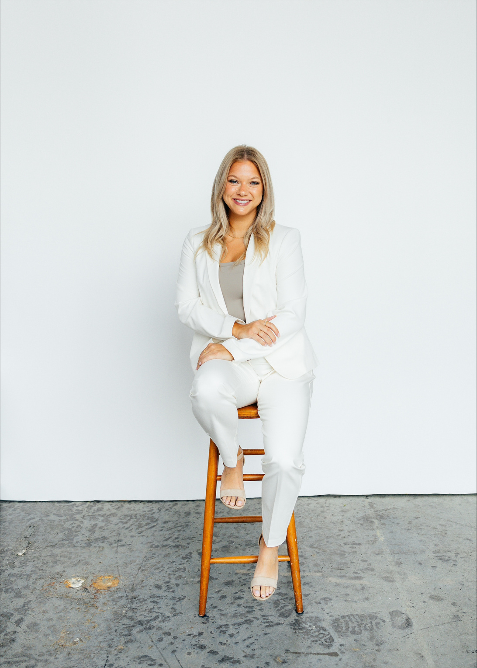
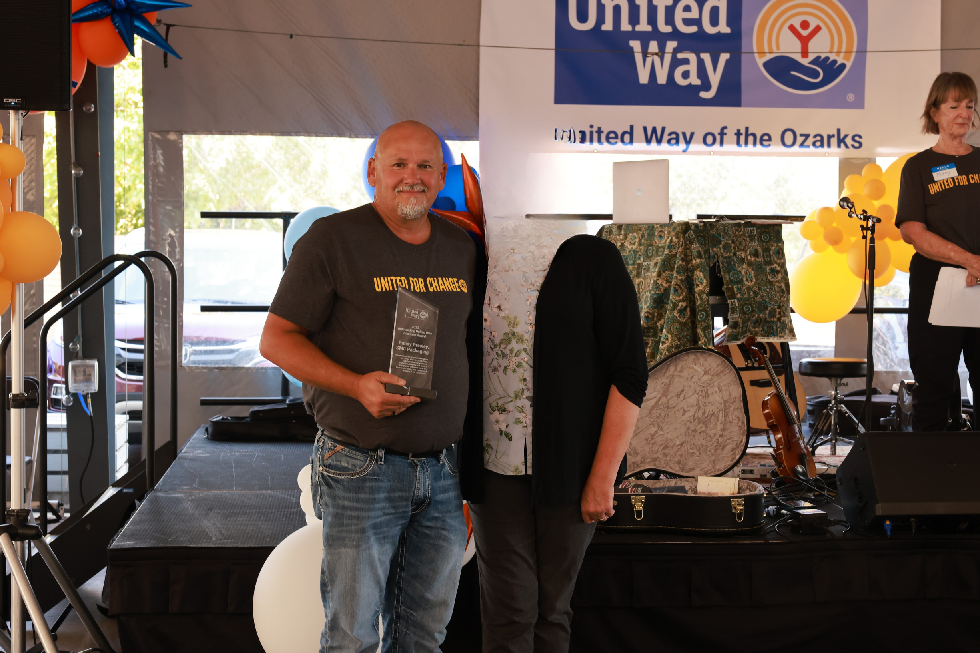
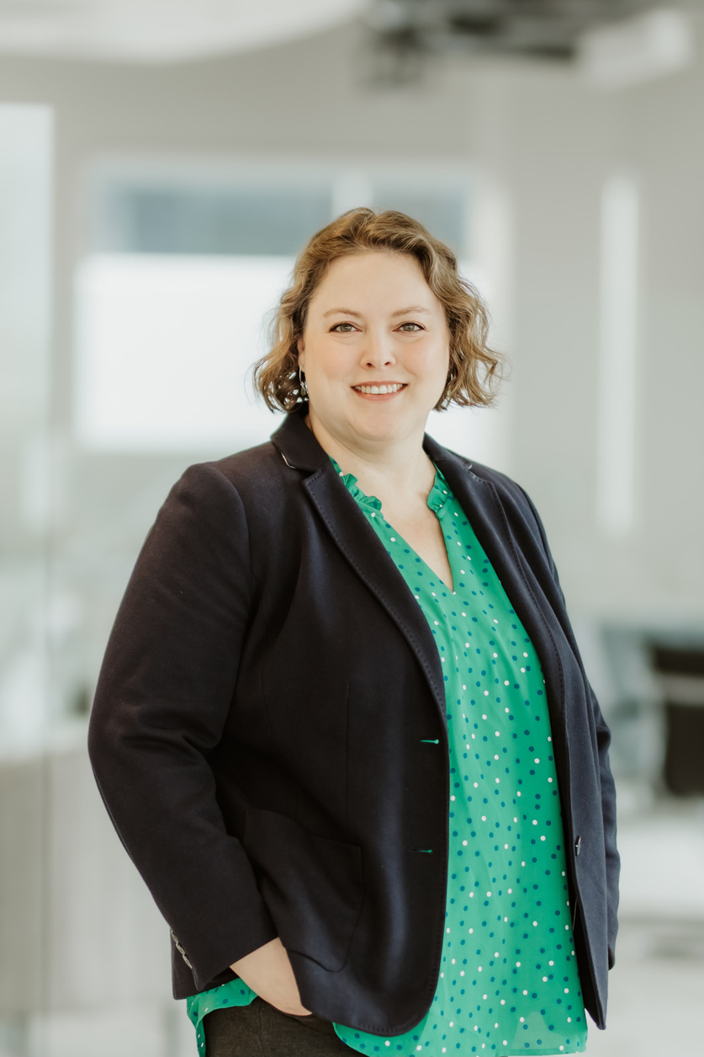
OUR PANELISTS
WHITNEY MANN, CITY UTILITIES
SARAH BECKLEY, TRANSLAND
RANDY PRESLEY, SMC PACKAGING
JEN JOHNSON, SPRINGFIELD AREA CHAMBER OF COMMERCE
Notes:
12:20
Janelle & Bill
Congratulate those that are here that won awards at the Campaign Celebration:
Whitney Mann, Rising Star
Sarah Beckley, Revitalization
Emily Logan, Most Creative Campaign Event

Slide 19

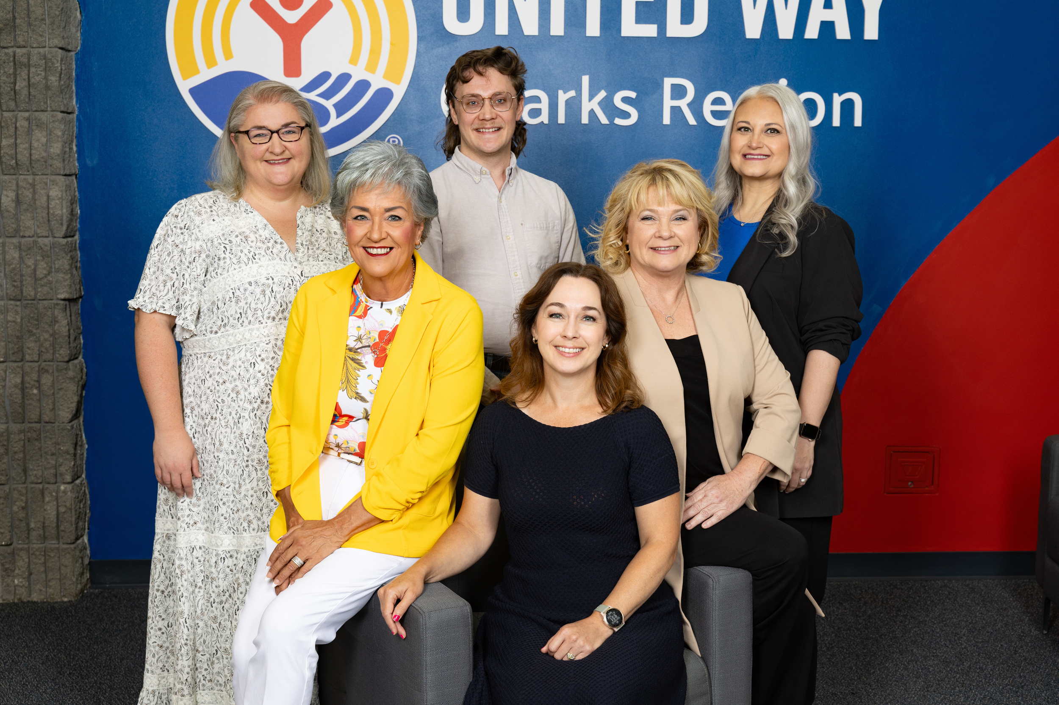

THANK
YOU!
320 N Jefferson Ave
417-863-7700
liveunited@uwozarks.org
Notes:
12:50
Remind them to grab swag for themselves for coming
Grab paper pledge forms if needed
They can grab popcorn and lilac bundles for any committee members they have
TAKE PICTURE

